Slide 1
COVID-19
Situation Report
09/18/2020
Kimothy Smith

Slide 2
Epidemiology, like climatology — or for that matter economics — involves trying to model complex systems, so that no prediction ends up being exactly right. And the chains of cause and effect are long enough that the consequences of bad policy take some time to become completely apparent: Florida began reopening in early May, but Covid-19 deaths didn’t spike until July. But we’re talking about weeks, not decades, and the story of the coronavirus is as clear as such things ever get.
— Paul Krugman, The New York Times

Slide 3
Overview
The Numbers
World
USA
Western US
Tribal Lands
New News
Age/Gender/Race Susceptibilities
Tissue Affinities and Chronic Conditions
What about the Flu?
Vaccines
Testing, Testing, Testing…
Types of Tests; Pros and Cons

Slide 4
The Numbers - World

Slide 5
The Numbers - USA

Slide 6
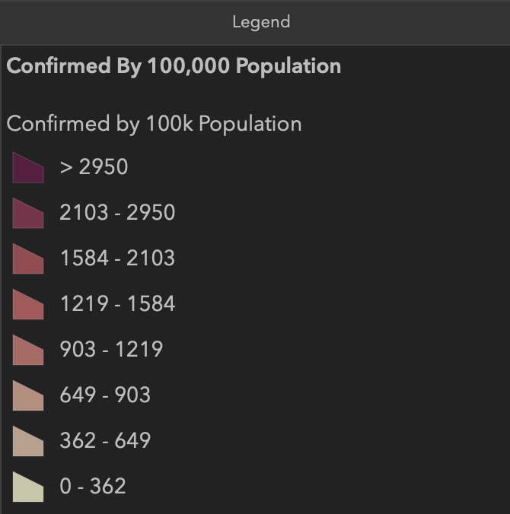
The Numbers - Western United States

Slide 7
The Numbers - Western United States and Tribal Lands

Slide 8
The Numbers - COVID-19 on Tribal Lands

Slide 9
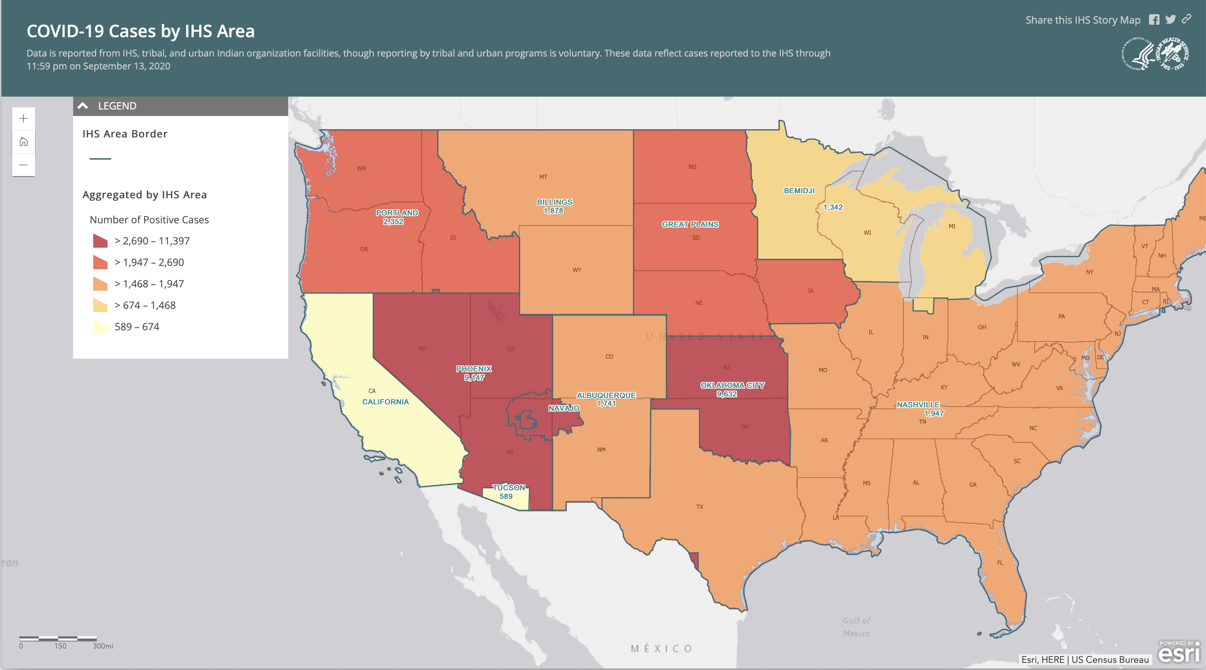

Slide 10
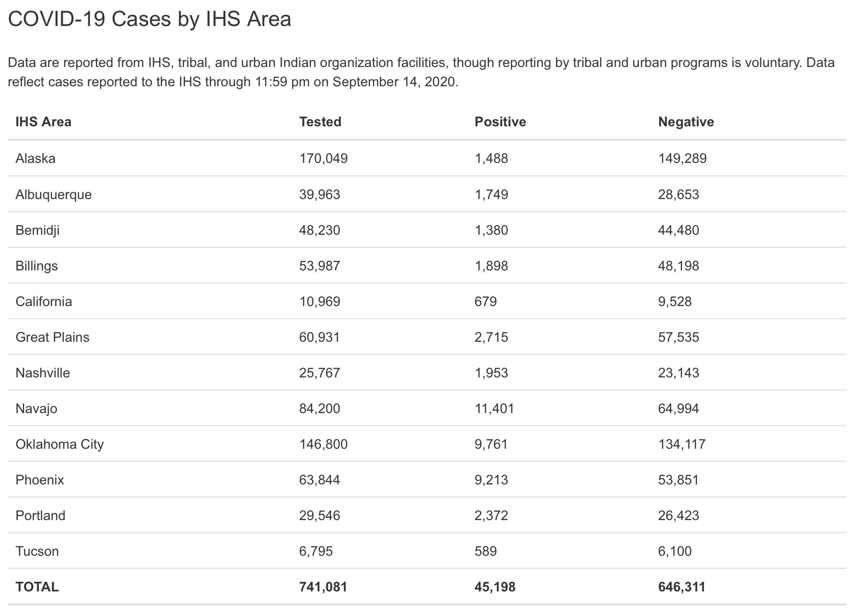
Positivity
0.9%
4.4%
2.9%
3.5%
6.2%
4.5%
7.6%
13.5%
6.6%
14.4%
8.0%
8.7%
6.1%

Slide 11
New News
Age and Race – New Statistics from CDC This Week
The coronavirus is killing Hispanic, Black and American Indian children at much higher numbers than their White peers
The numbers —391,814 known cases and 121 deaths among people under the age of 21 from February to July.
More than 75 percent (293,860) have been Hispanic, Black and American Indian children, even though they represent 41 percent of the U.S. population
Of the children and teens killed, 45 percent were Hispanic, 29 Black and 4 percent American Indian
Tissue Affinities
Study indicates that COVID-19 can infect human brain cells and causes damage
What about the Flu?

Slide 12
New News - cont’d
What about the Flu?
We know that coinfection with multiple respiratory viruses is possible
Coinfection of SARS-CoV-2 and influenza virus was common during the initial COVID-19 outbreak in Wuhan, China, and patients who experienced coinfection had a higher risk of poor health outcomes.
Reported incidence of seasonal influenza has been uncharacteristically low in the southern hemisphere so far this year but the reason for this is unclear
It may be that the case load simply appears lower because of insufficient testing and reporting
Or, that the social distancing measures put in place to help stop the transmission of SARS-CoV-2 have reduced the transmission of influenza virus as well - New York's lockdown was effective in reducing the spread of coronavirus by 70 percent

Slide 13
New News - cont’d (2)
Vaccines
There is currently not an approved, safe and effective COVID-19 vaccine available in the US
While development of a COVID-19 vaccine has been progressing very rapidly, some issues have developed in human trials
It is unlikely that an approved, safe and effective COVID-19 vaccine will be available before 2021 – my opinion
Once an approved, safe and effective COVID-19 vaccine is available, distribution will be complicated, cumbersome, and slow (and, likely politicized)
“Trust is gained in drops and lost in buckets. This phrase echoes through my head as I watch the rush to find treatments and vaccines for COVID-19. But in this moment, the trust we have built, drop by drop, in scientific leadership across government is at risk of being lost through political pressure.”
— Sudip S. Parikh, CEO, American Association for the Advancement of Science

Slide 14
Testing, Testing, Testing…
“Testing is critically important for pandemic response, as a tool for gathering information on who is infected, where, and when. Accurate estimates of the number of people infected within a population are the cornerstone of evidence-based public health decision-making during an epidemic, and can help hospitals and other frontline services plan, prepare, and more effectively respond.”
— Dr. Claire Standley, Assistant Research Professor, Center for Global Health Science and Security at Georgetown University
“Test more; test often.”
— Dr. Kimothy Smith

Slide 15
Testing, Testing, Testing…
There are three categories of COVID-19 testing being provided
PCR – actually, RT-PCR, targets the RNA (genetic material) of the COVID-19 virus
Antigen – targets protein(s) of the COVID-19 virus
Antibody – serology-based, targets the antibodies (IgM, IgG, and IgA) produced by the body in response to infection by the COVID-19 virus
RT-PCR and Antigen testing are “truly” diagnostic tests, confirming presence/absence of COVID-19 virus in a clinical sample
Antibody testing is good to determine exposure status and timing of exposure to COVID-19 virus. Can indicate current or ongoing infection.

Slide 16
Testing, Testing, Testing…
Comparison of RT-PCR and Antigen COVID-19 Test Attributes
 | Diagnostic Test Type
Attribute | RT-PCR | Antigen
Time | 15 minutes to 2 hours | 1 to 2 minutes
Cost | Moderate: $100 to $300 per test | Low: a few dollars per test
Sensitivity/Specificity | Extremely sensitive and specific | Moderately sensitive and specific
Limit of Detection | Extremely low: < 100 virus particles | Moderate: varies
Simplicity/Complexity | Moderate complexity | Very simple
Availability | > 100 RT-PCR tests with EUA | < 10 Antigen tests with EUA
Lab-based/Point of Care/Home Test | Lab-based or Point of Care | Point of Care or Home Test
False Positive/False Negative | Very low false positives/negatives | Moderate false positives/negatives
Class: Confirmatory/Screening | “Gold Standard” confirmatory test | Screening: + need confirmation

Slide 17
Testing, Testing, Testing…
Where we find ourselves…
RT-PCR test results can take up to 10 days – too long to have any benefit
Few testing locations whether drive-through clinic/hospital-based
Few Antigen tests available but manufacturing is ramping up (still have confirmation testing needed for positives)
In an Ideal World…
High quality testing (RT-PCR) would come to us – mobile labs
Results would be reported quickly, in hours not days
Testing would be available prior to and ongoing for
Workplaces (essential workers; casinos)
Schools
Cultural Events

Slide 18
COVID-19
Situation Report
09/18/2020
Kimothy Smith

