Slide 1
Update on Tribal Gaming 6/19/2020
Ted Hartwell
Desert Research Institute
Ted.Hartwell@dri.edu
(702) 858-2441

Slide 2
Tribal Gaming
FY18 revenue = $33.7 billion (4.1% increase over FY17)
FY19 estimated = $35.1 billion
Incredibly important economic driver for many tribes, both both jobs and funding of tribal government and services

Slide 3
Timeline to Closure
March 10 – Betting on Sports America conference canceled
March 11 – Worker at MGM-owned Yonkers Raceway dies
March 11 – Guest at the Mirage tests positive
March 11-12 – Casinos announce additional measures
March 13 – Major sports cancellations/suspensions
March 13 – NIGA conference postponed
March 13 – MGM closes clubs
March 14 – MGM employees at Luxor and Wet Republic test positive
March 14 – Casino shutdowns in 7 states (RI, IN, MS, OH, IL, PN, NY)
March 14 – San Manuel closes in California
March 15 – Shows on Strip shut down
March 15 – Tribes across country begin to shut down
March 16 – Wynn and MGM announce closure of all Nevada properties
March 17 – Sisolak orders closure of all non-essential businesses
March 18 – NIGA requests $18 billion from Congress over 6 months

Slide 4
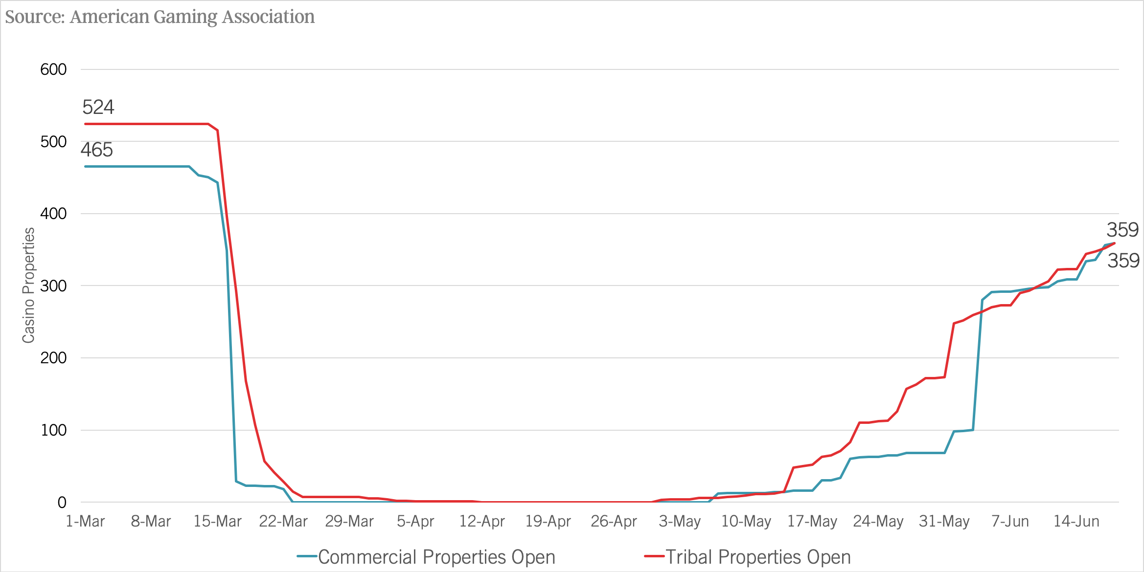
Casino Closings and Reopenings
June 18, 9AM EDT
(69% of tribal and 77% of commercial)

Slide 5
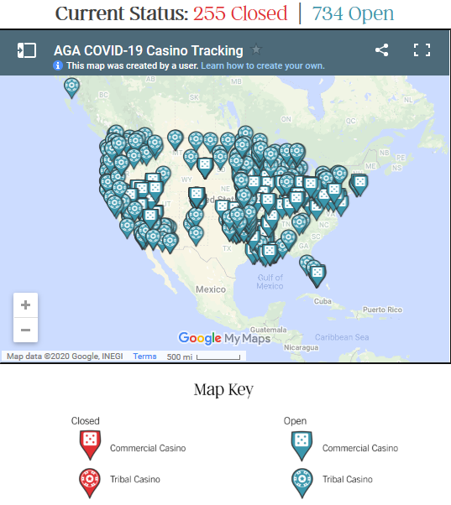
Casinos that have reopened (June 19, 10AM EDT)
https://www.americangaming.org/research/covid-19-casino-tracker/

Slide 6
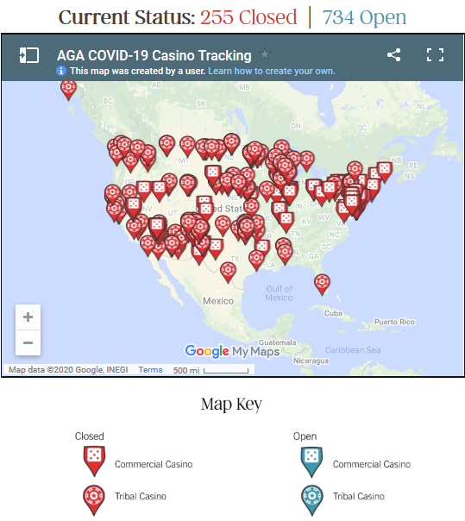
Casino that are still closed
https://www.americangaming.org/research/covid-19-casino-tracker/

Slide 7
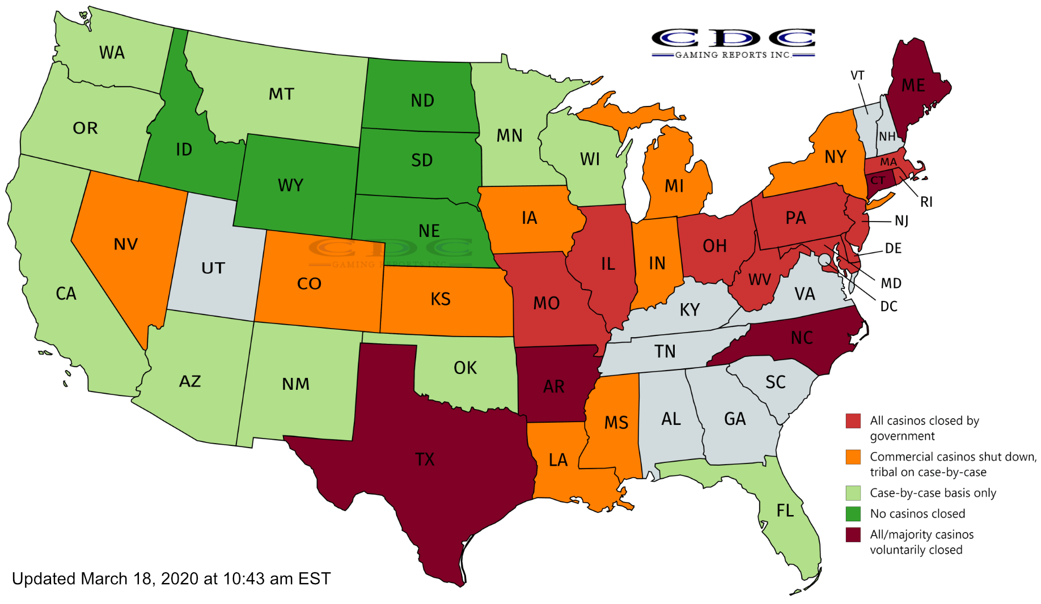
Casino Closings as of March 18
https://www.cdcgamingreports.com/united-states-coronavirus-casino-closures-mapped/

Slide 8
Timeline to Reopening
April 22 – Wynn Resorts posts 23-page Health and Disinfection Program (https://www.visitwynn.com/documents/Wynn-Health-Plan.pdf)
April 22 – Nevada Gaming Control Board (NGCB) releases guidelines (https://gaming.nv.gov/modules/showdocument.aspx?documentid=16731)
May 1 – Coeur d’Alene Casino (tribal) reopens (masks required for all)
May 4 – Commercial casinos in Montana reopen
May 5 – Northern Quest Casino (tribal) reopens (every other machine, every other table w/max 2 per table unless from same household), but within 3 days changed some of slot measures due to guest feedback
May 7-17 – Tribal casinos begin to reopen in SD, OK, ND, AZ, CA, MI, NY
May 18-26 – Commercial casinos open in LA, AR, MS, and tribal in NC, OR, FL
June 1-12 – Floodgates open with regards to commercial casinos, NV on June 4
June 17 – NGCB requires guests to wear face covers at tables if no artificial barriers in place to protect employees

Slide 9
What Wynn’s Health Plan Includes
Non-invasive thermal temp scans
All employees w/face coverings and guests encouraged
24-hour disinfection team (detailed cleaning protocols for slots/tables/restaurants)
~300 sanitation stations throughout resort
Appropriate/comfortable physical distancing in all games/restaurants/retail spaces
Enhanced employee training
Elevator restrictions
Occupancy limits
No-touch check-in/game play

Slide 10
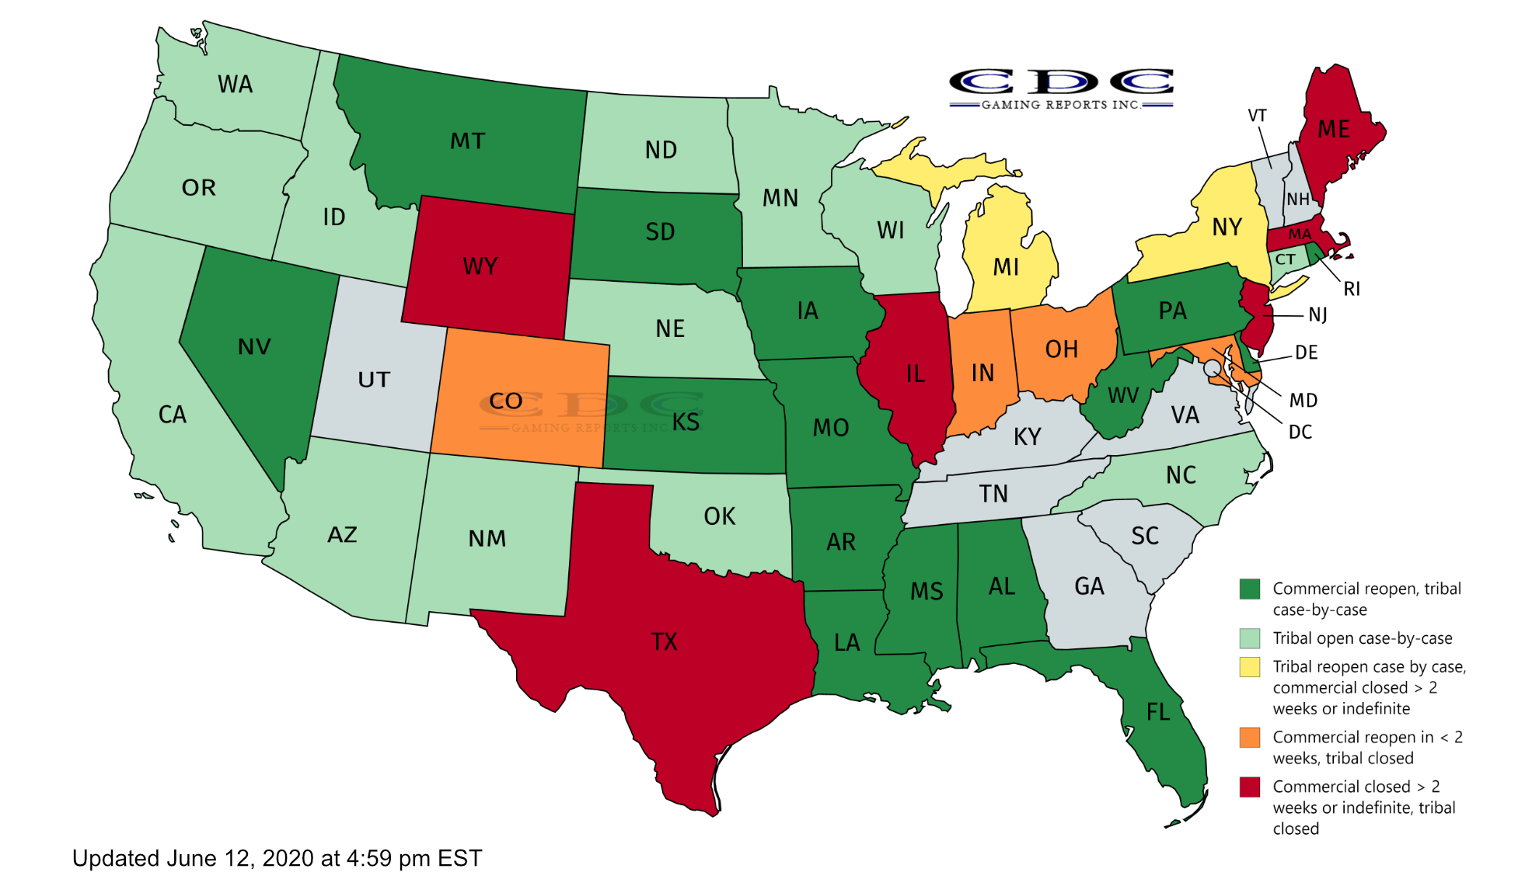
Casino Reopenings as of June 12
https://www.cdcgamingreports.com/mapping-the-recovery-united-states-casino-reopenings/

Slide 11
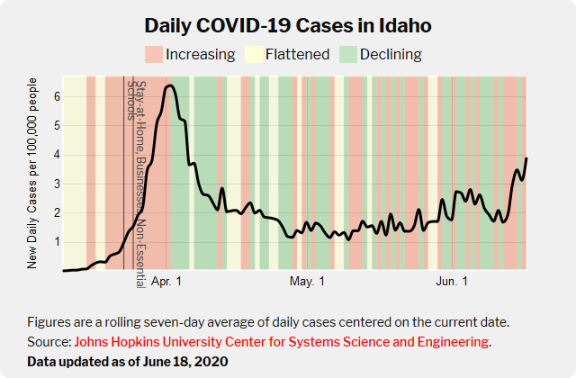
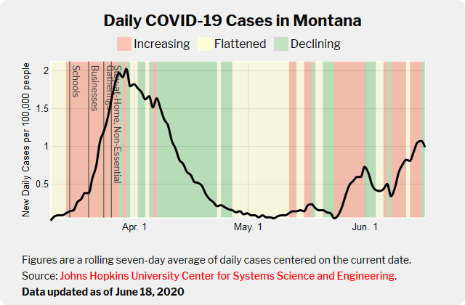
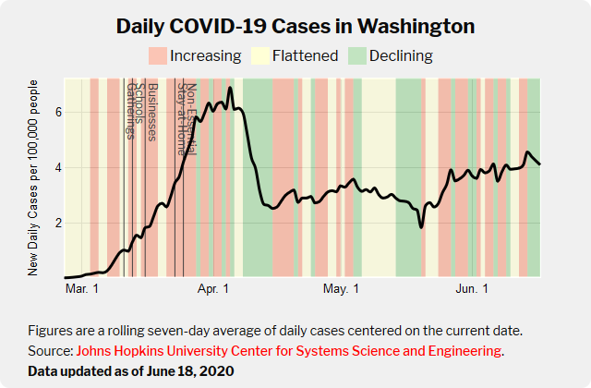
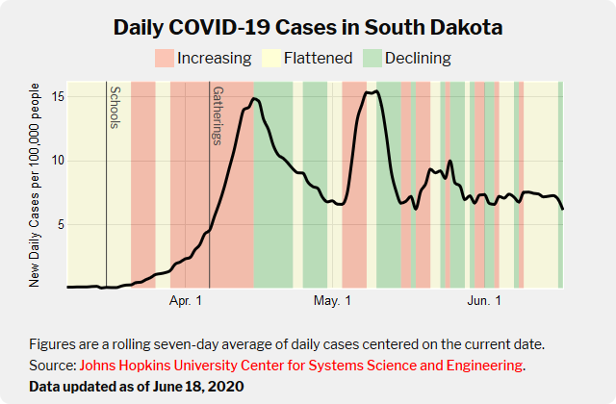
Casino reopenings/COVID-19

Slide 12
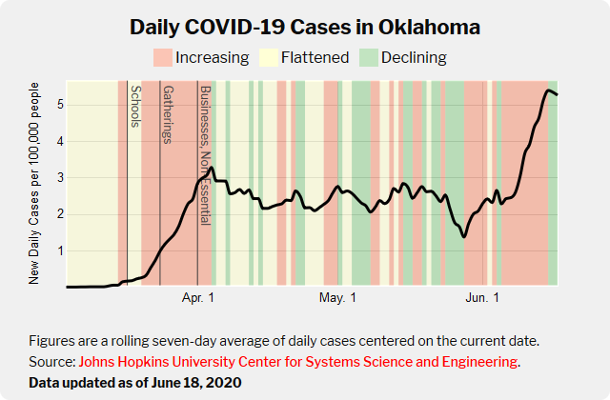
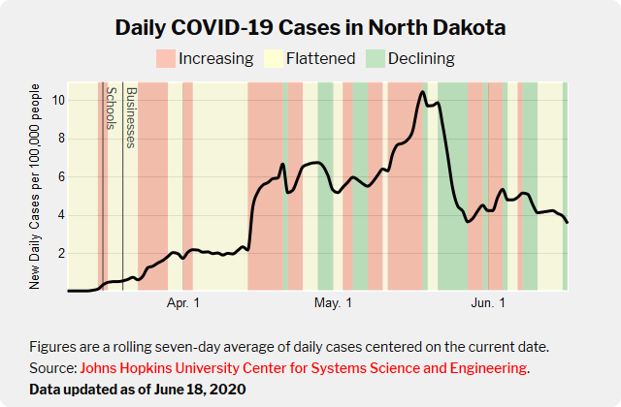
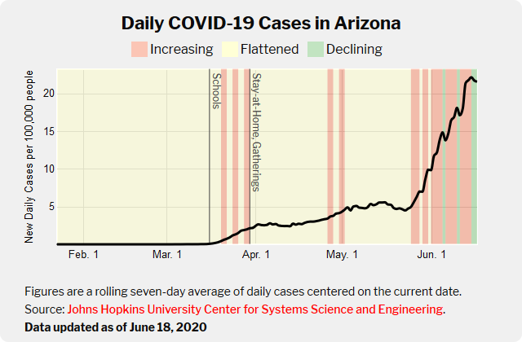
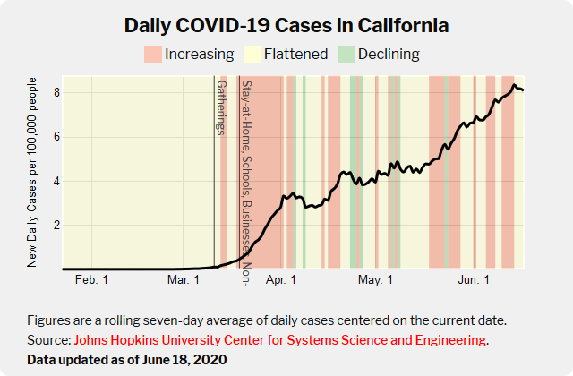
Casino reopenings/COVID-19

Slide 13
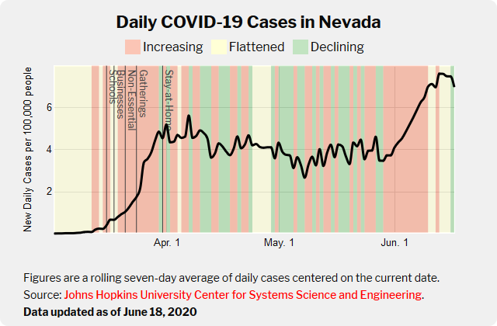
Casino reopenings/COVID-19

Slide 14
General observations
Casino reopenings are patchwork, and mirror the US as a whole
Some tribes electing to reopen sooner than state governments allowing commercial, and some later
Generally, both tribal and commercial across US are implementing some version of Wynn standards, with additional innovations such as remote queuing
Compliance by casino properties as well as patrons is inconsistent across commercial and tribal properties
Most reopened tribal properties report brisk and even record business---good economic news, but too early to gage ultimate impact on COVID-19 spread

