Slide 1
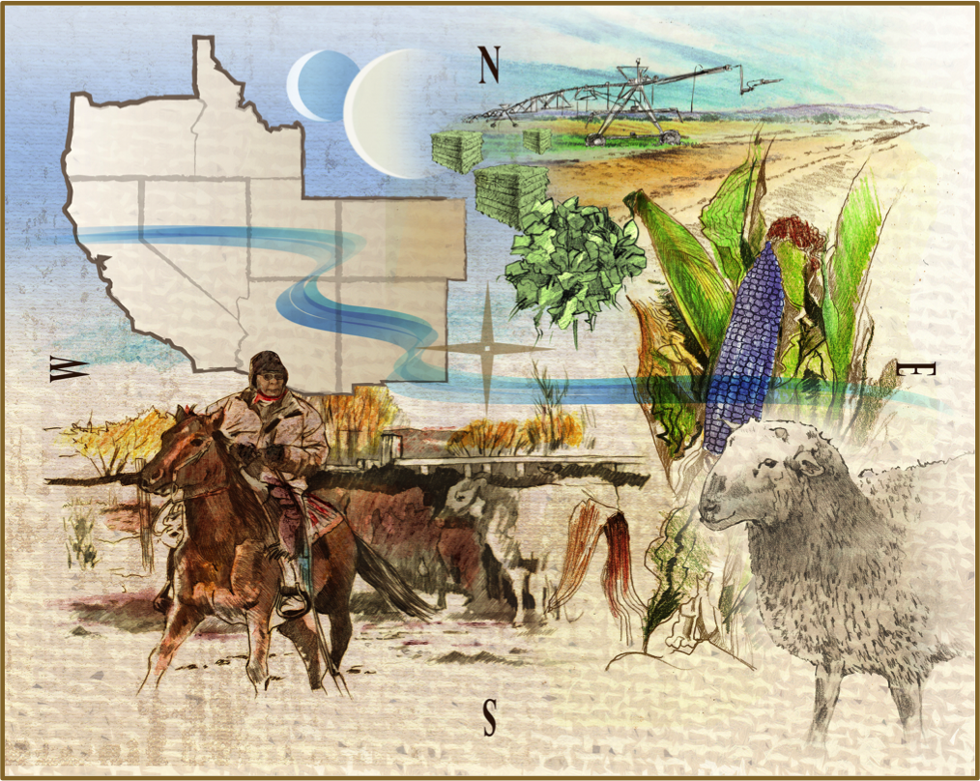
“Current Drought Conditions & Outlooks for the Western United States” for: Native Waters on Arid Lands Desert Research Institute July 17, 2020
presented by: David Miskus
Climate Prediction Center/NCEP/NWS/NOAA/DOC

Slide 2
Presentation Contents
USDM Background & Interpretation;
Current Drought Monitor (7/14/20) Conditions;
Latest Forecasts & Outlooks (Days 1-7; 6-10 and 8-14 Day ERFs; Week 3-4; 1- & 3-Month T & P LLFs; MDO & SDO; ENSO);

Slide 3
USDM Background
A consolidation of current conditions and current impacts into one comprehensive national drought map. The DM…
Is NOT a model (manually made weekly based off previous map);
Is NOT just interpreting precipitation;
Is NOT a forecast (see Drought Outlook) or drought declaration;
Incorporate local expert input (by email, impact reports, & tweets);
Identifying impacts (“S” <6-months; “L” >6-months; “SL” both);
Be as objective as possible (using percentiles methodology). The physical data & indicators must support the map depiction. The impact data validates physical data;
“Convergence of Evidence” approach; percentile ranks for intensity;

Slide 4
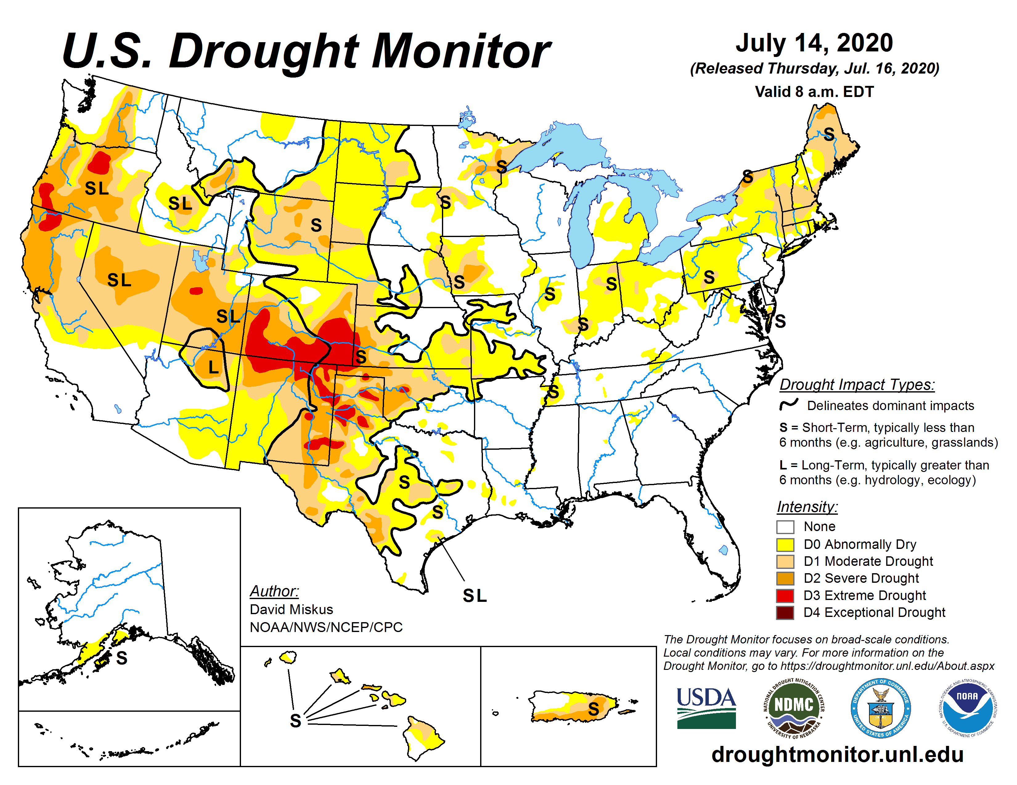
USDM Interpretation
Drought Intensity Categories – by Percentiles
D0 Abnormally Dry (30%tile)
(once every 3-5 years)
D1 Drought – Moderate (20%tile)
(once every 5-10 years)
D2 Drought – Severe (10%tile)
(once every 10-20 years)
D3 Drought – Extreme (5%tile)
(once every 20-50 years)
D4 Drought – Exceptional (2%tile)
(once every 50+ years)
Impacts (“S” <6-months; “L” >6-months; “SL” both);

Slide 5
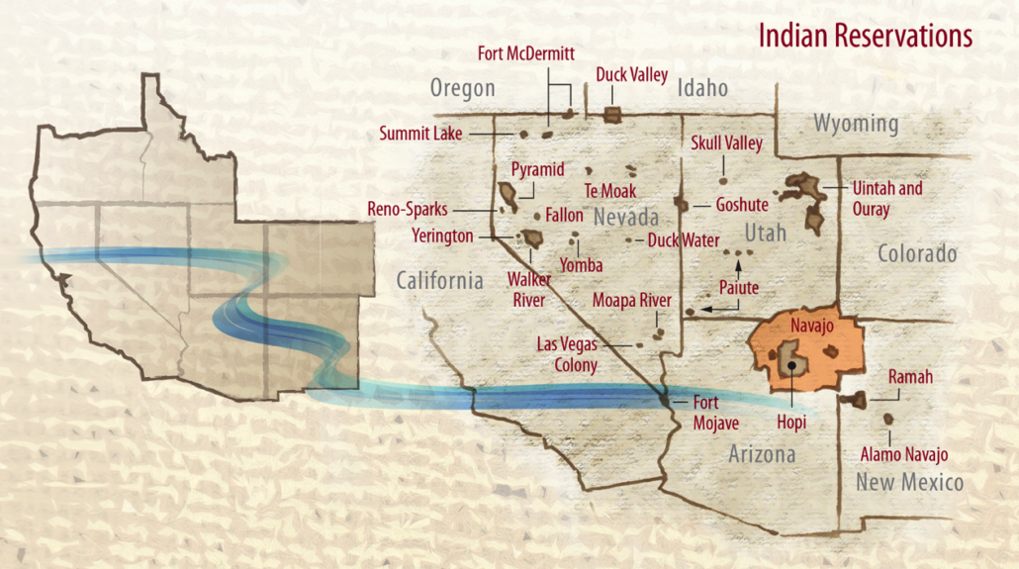
Western Tribal Reservations
MT
SD

Slide 6
Current Drought Conditions
Focus on:
N Rockies &
Upper MO Valley;
Great Basin;
Southwest;

Slide 7
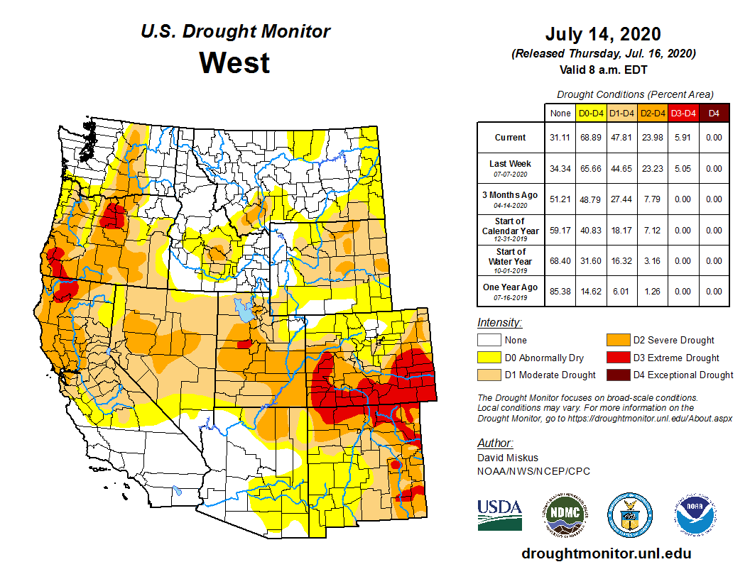
Current Drought Conditions

Slide 8
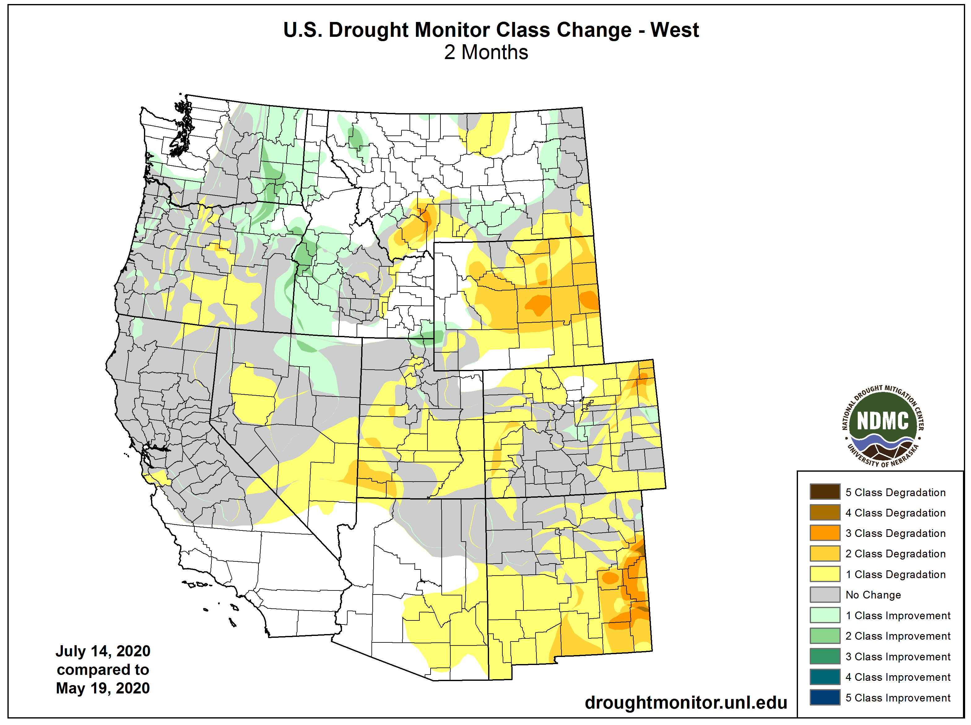
Current Drought Conditions

Slide 9
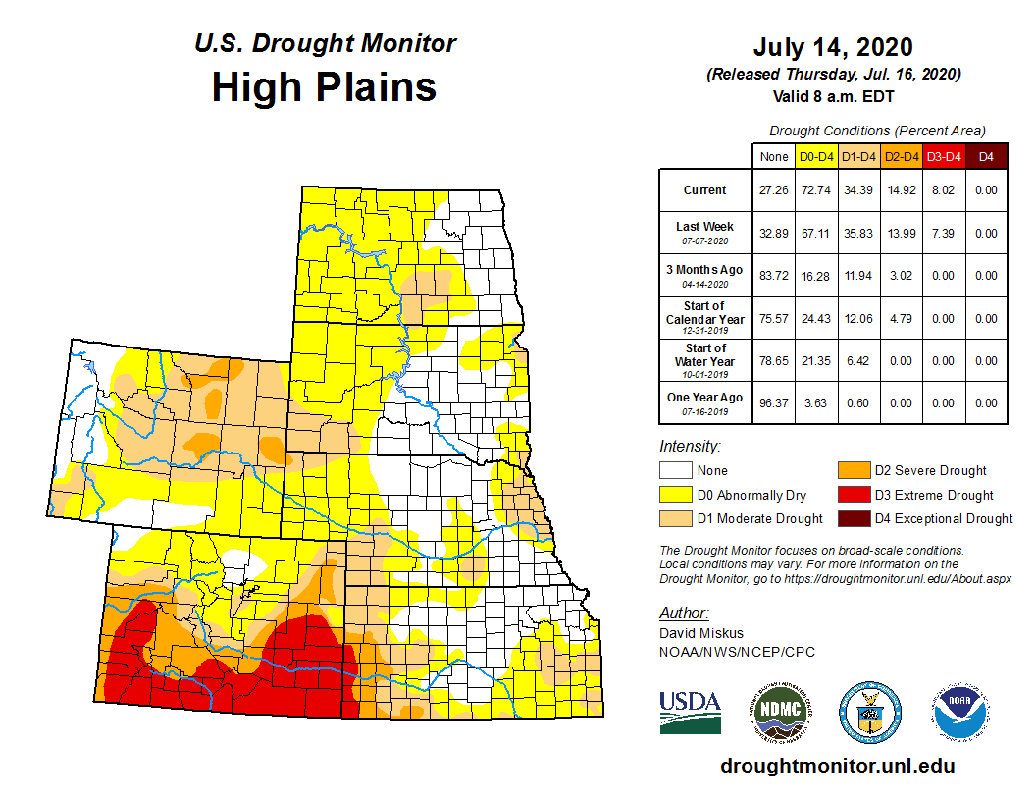
Current Drought Conditions

Slide 10
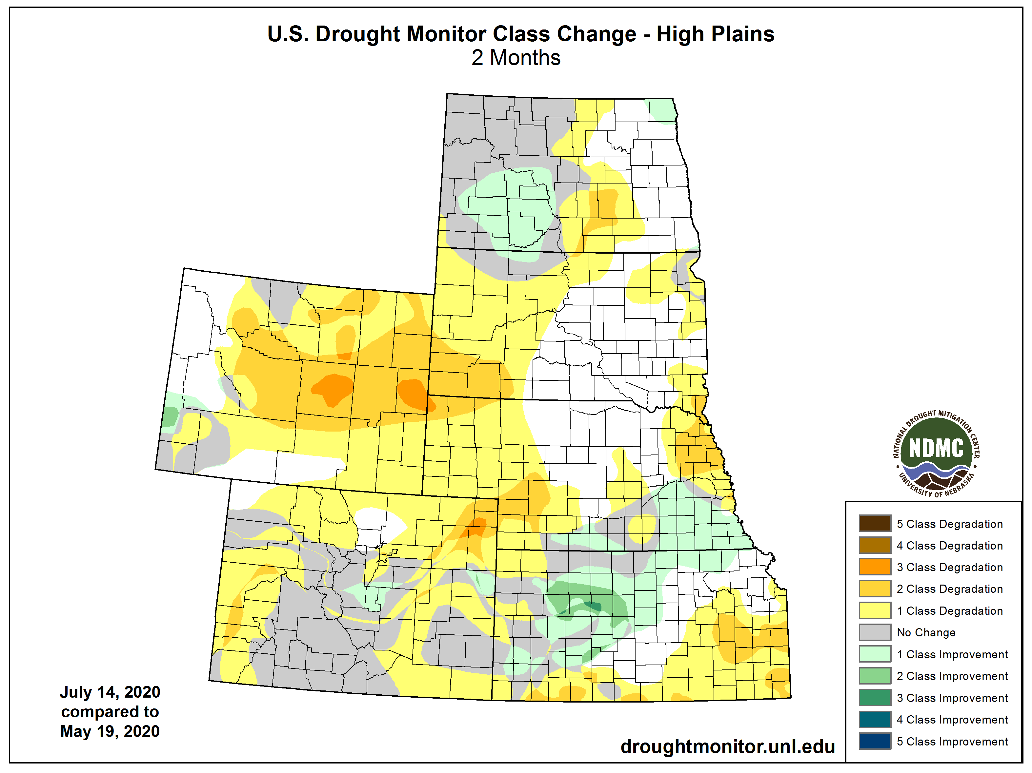
Current Drought Conditions

Slide 11
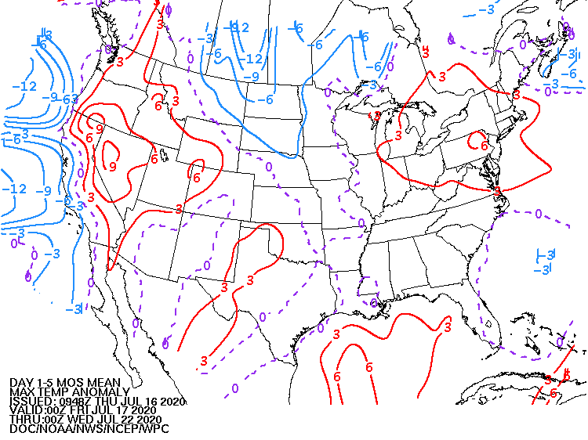
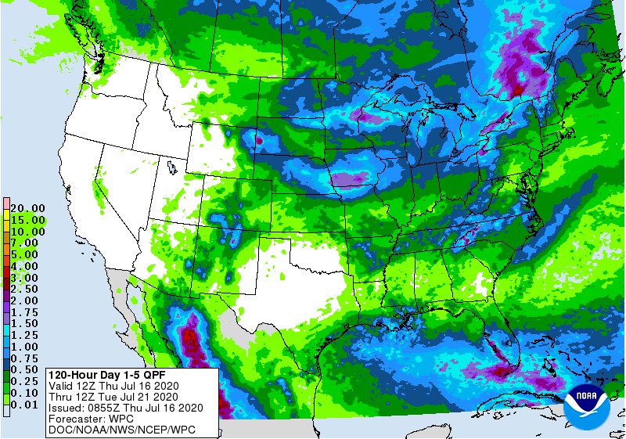
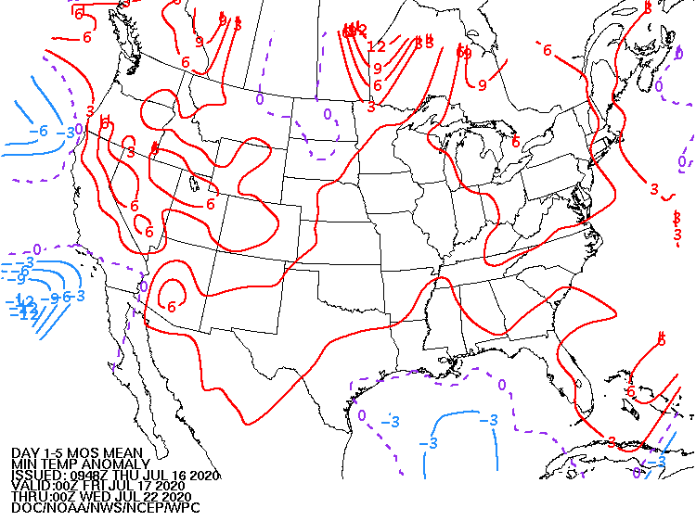
Current Forecasts (Days 1-5)
Days 1-5 Quantitative Precipitation Amounts
Days 1-5 MaxT Anom
Valid 12 GMT July 16 – 12 GMT July 21, 2020
Days 1-5 MinT Anom

Slide 12
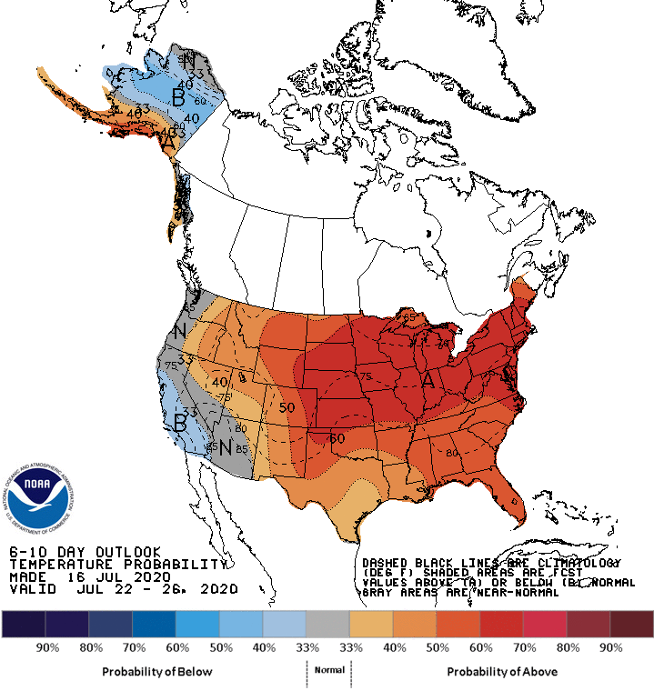
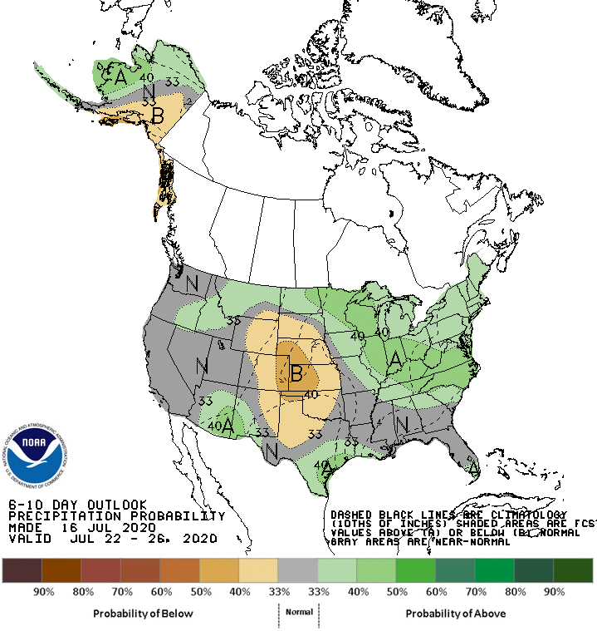
Current Forecasts (6-10 Day ERFs)
Valid July 22 - 26, 2020

Slide 13
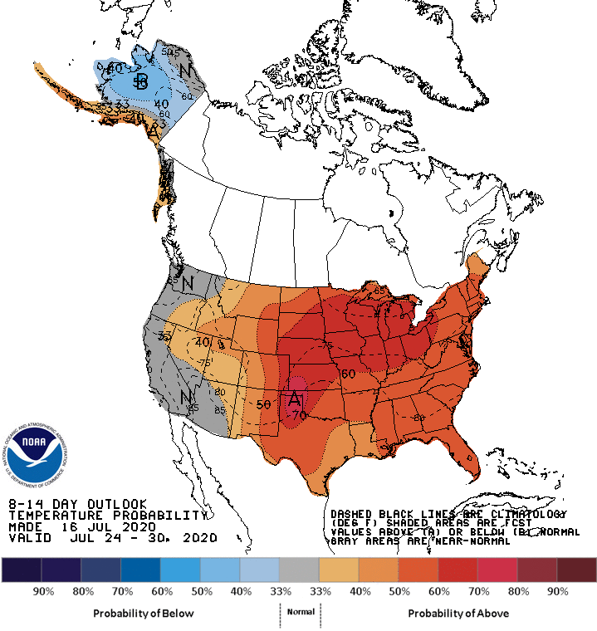
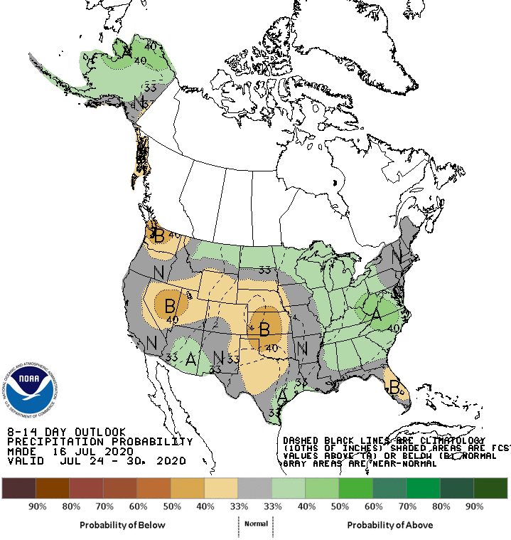
Current Forecasts (8-14 Day ERFs)
Valid July 24 - 30, 2020

Slide 14
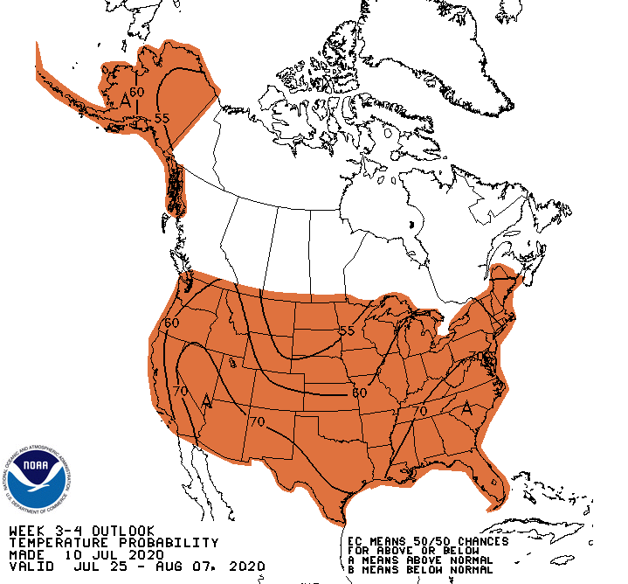
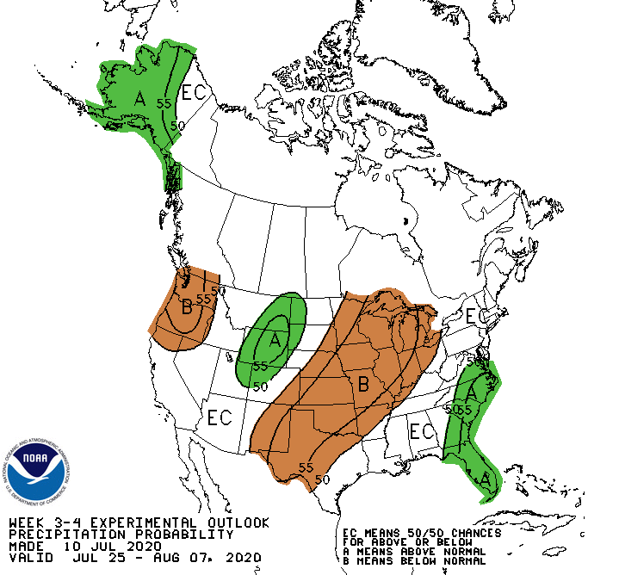
Current Outlooks (Week 3-4)
(Updated every Friday at 3pm Eastern)
Precipitation - Experimental
Valid July 25 – Aug. 7, 2020

Slide 15
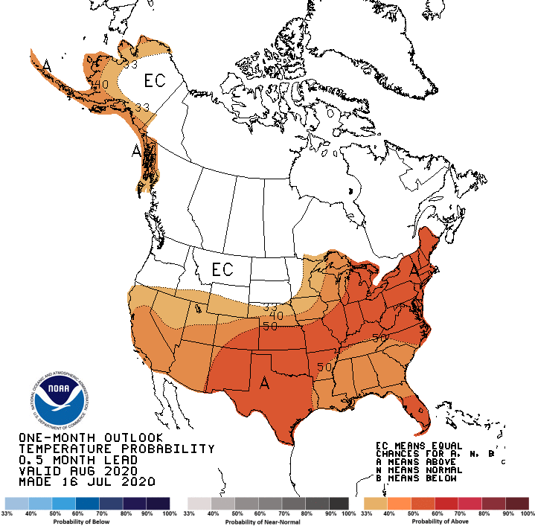
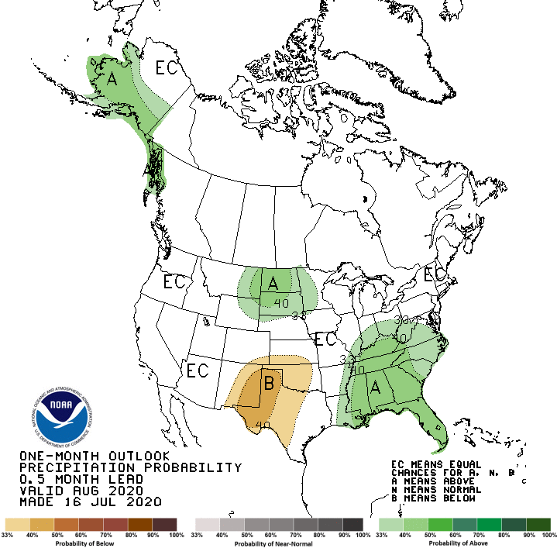
Current Outlooks (1-Month LLFs)
August 2020

Slide 16
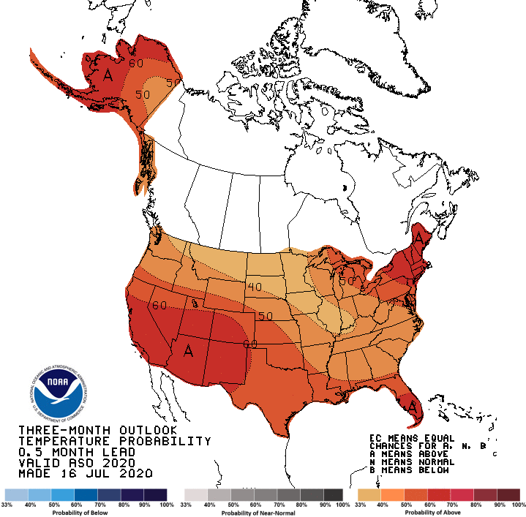
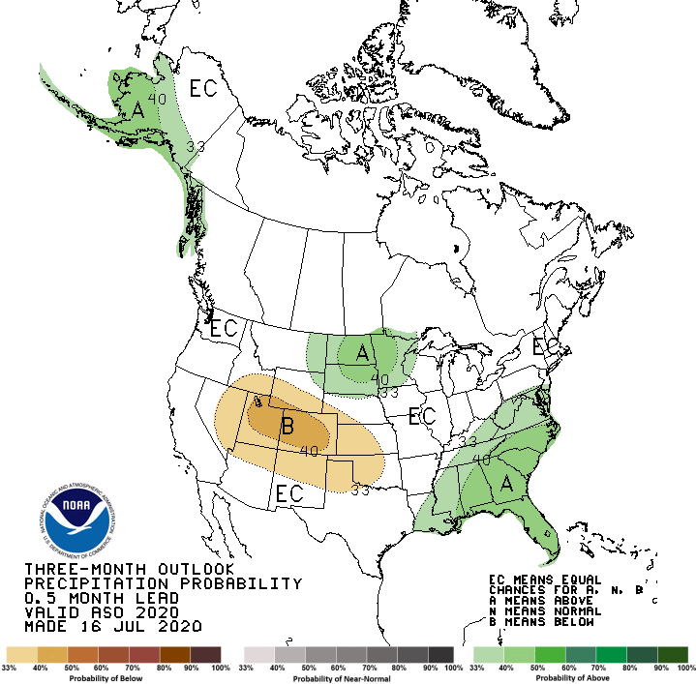
Current Outlooks (3-Month LLFs)
ASO 2020

Slide 17
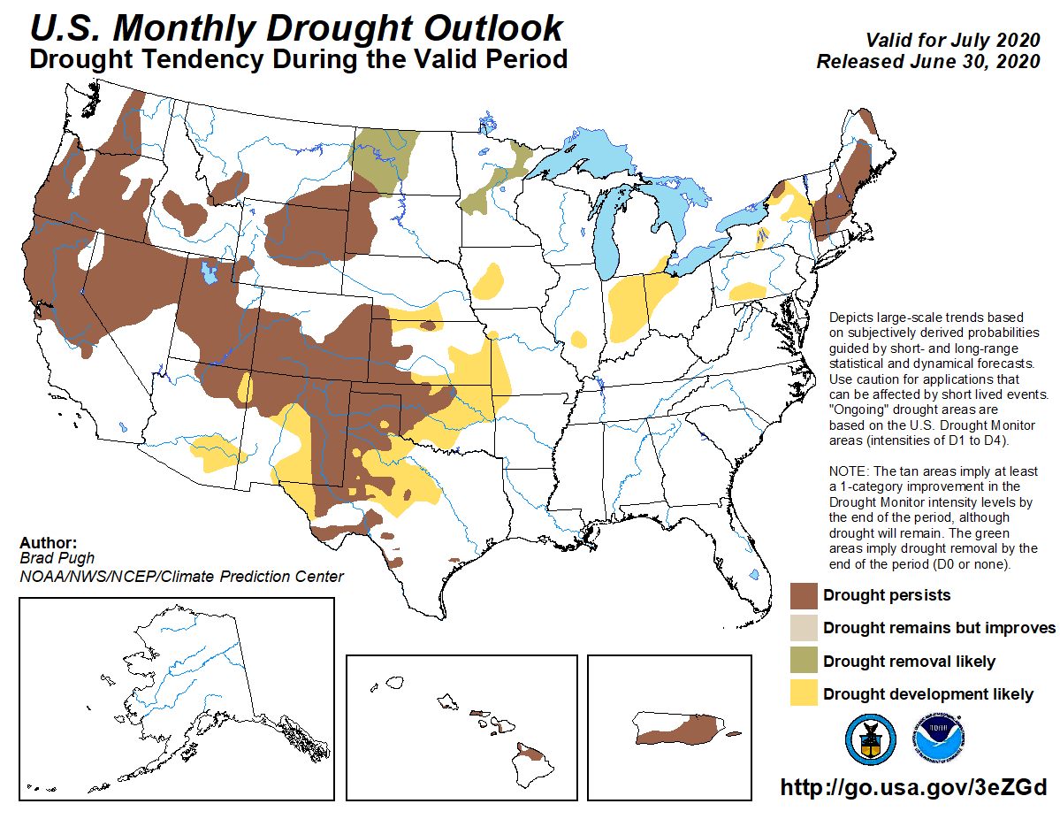
Current Outlooks (MDO)
(to be updated July 31 for August 2020)
July 2020

Slide 18
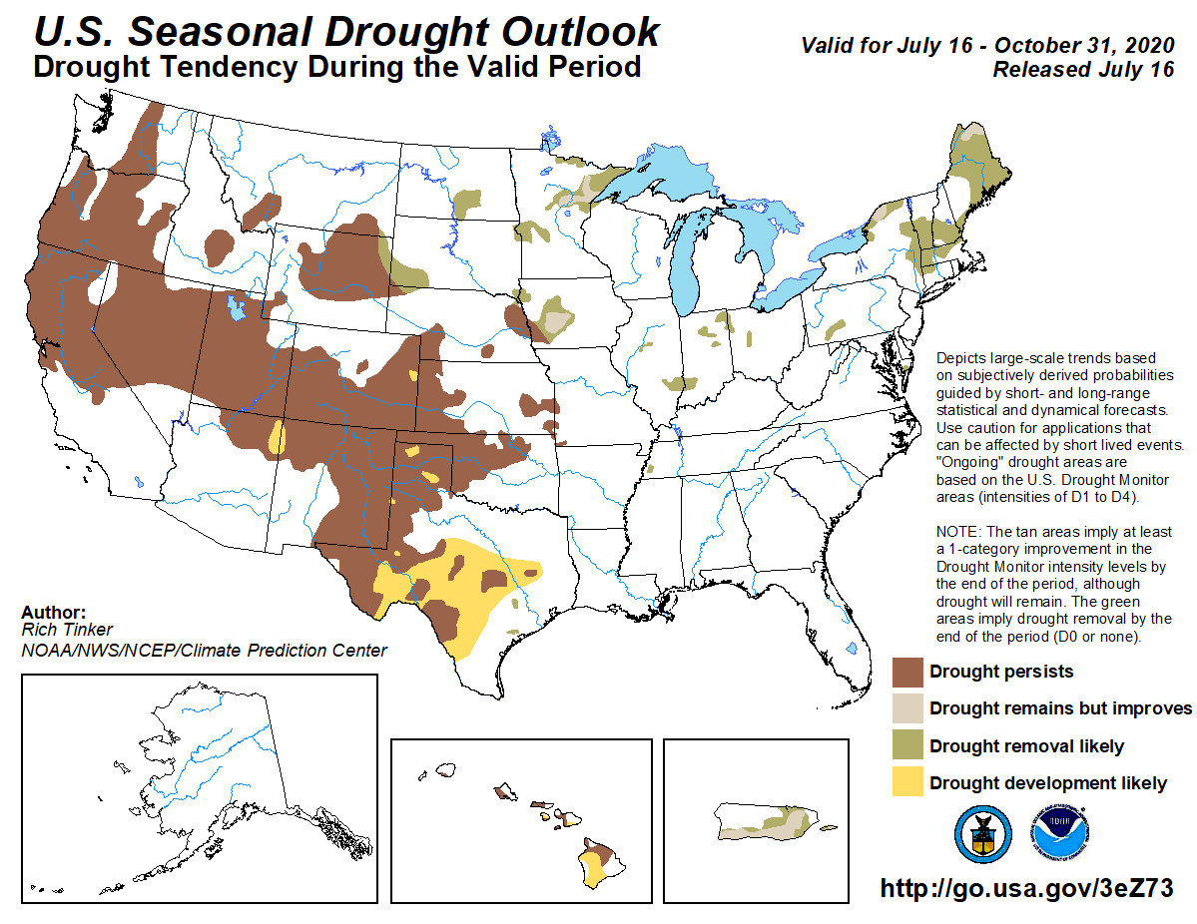
Current Outlooks (SDO)
ASO 2020

Slide 19
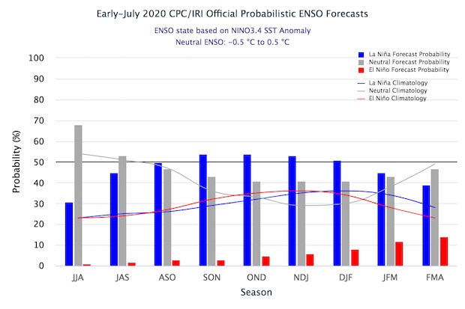
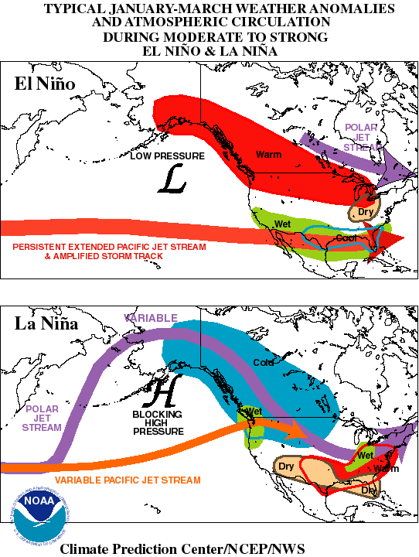
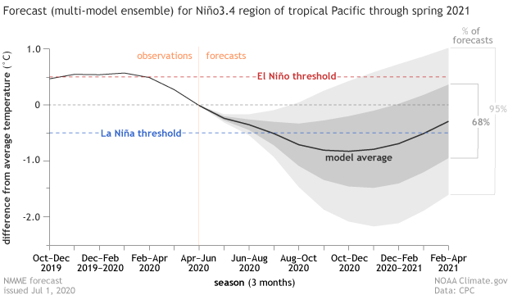
Current Outlooks (ENSO)
La Nina Watch: 50-55% chance
by Fall 2020 & into Winter 20-21

Slide 20
THANK YOU!
Any Questions, contact:
David.Miskus@noaa.gov
(301) 683-3453
CPC: https://www.cpc.ncep.noaa.gov/
USDM: https://droughtmonitor.unl.edu/

Slide 21
Extra Slides follow

Slide 22
USDM – “Convergence of Evidence”
A “Convergence of Evidence” approach.
Many types of drought “information” can be collectively analyzed
Determining if majority of information is “converging” (telling the same story) about the accuracy, or inaccuracy, of the drought as depicted by the DM;
Authors need to look at 100% of the data, but don’t believe in any one piece of data input 100% in making a decision…
Multiple indicators & many types of info are part of the analysis;
These data will identify different climatic & hydrologic parameters which are needed to understand the complete picture of a drought indicator’s performance and how they interact;
Impacts are the “ground truth”, yet aren’t monitored to the extent which other data are…you can’t measure what you don’t monitor!
The DM rates drought intensity by percentile ranks:
Can be applied to any parameter;
Can be used for any length of data record;
Puts drought into historical perspective (how many occurrences in a give period of time)

Slide 23
This can be any variable
(not just precipitation) with
adequate historical record
D0
D1
D3
D2
Example of a station with
100 years of data records.
D4

