Slide 1


Covid Pandemic Impacts on
Cattle Market Outlook
June 26, 2020
Shannon Neibergs
Extension Economist
Director Western Center Risk Management Education
School of Economic Sciences, WSU sneibergs@wsu.edu

Slide 2

Presentation objective
Review and discuss cattle and hay market outlook under current covid conditions
Briefly discuss the “50-14” proposed regulation for packers regarding AMAs
Briefly comment on LRP risk insurance

Slide 3
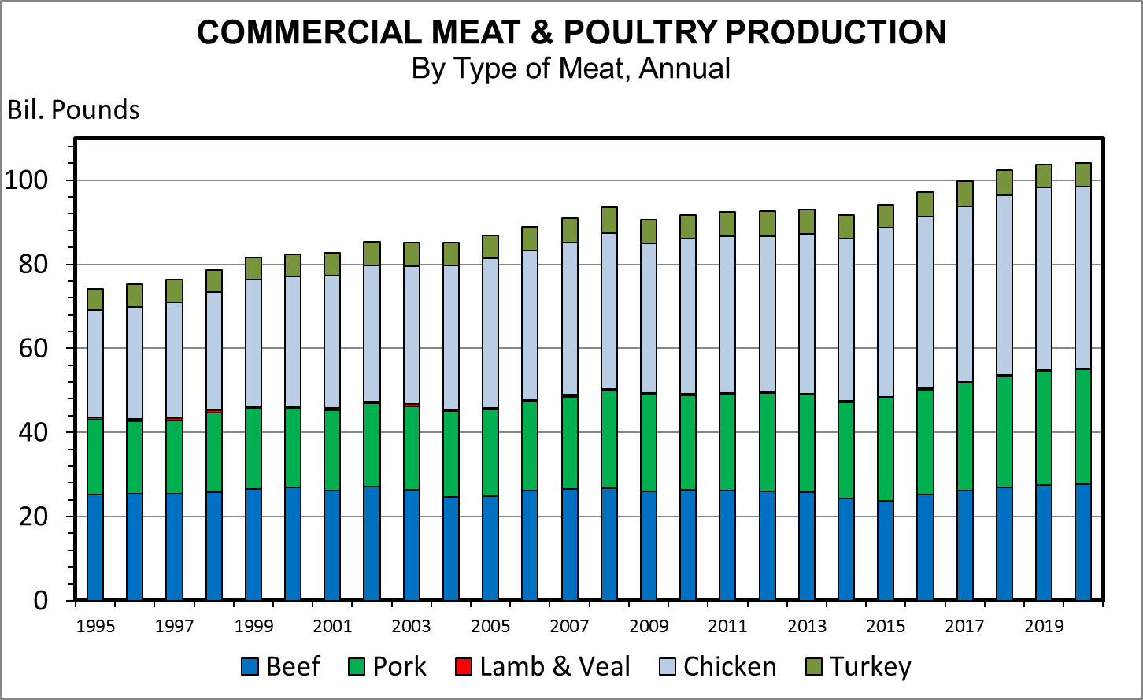
Pre-Covid projected record high supply of meat
+ 3.6%
+ 3.0%
+ 3.3%
+ 1.0%

Slide 4
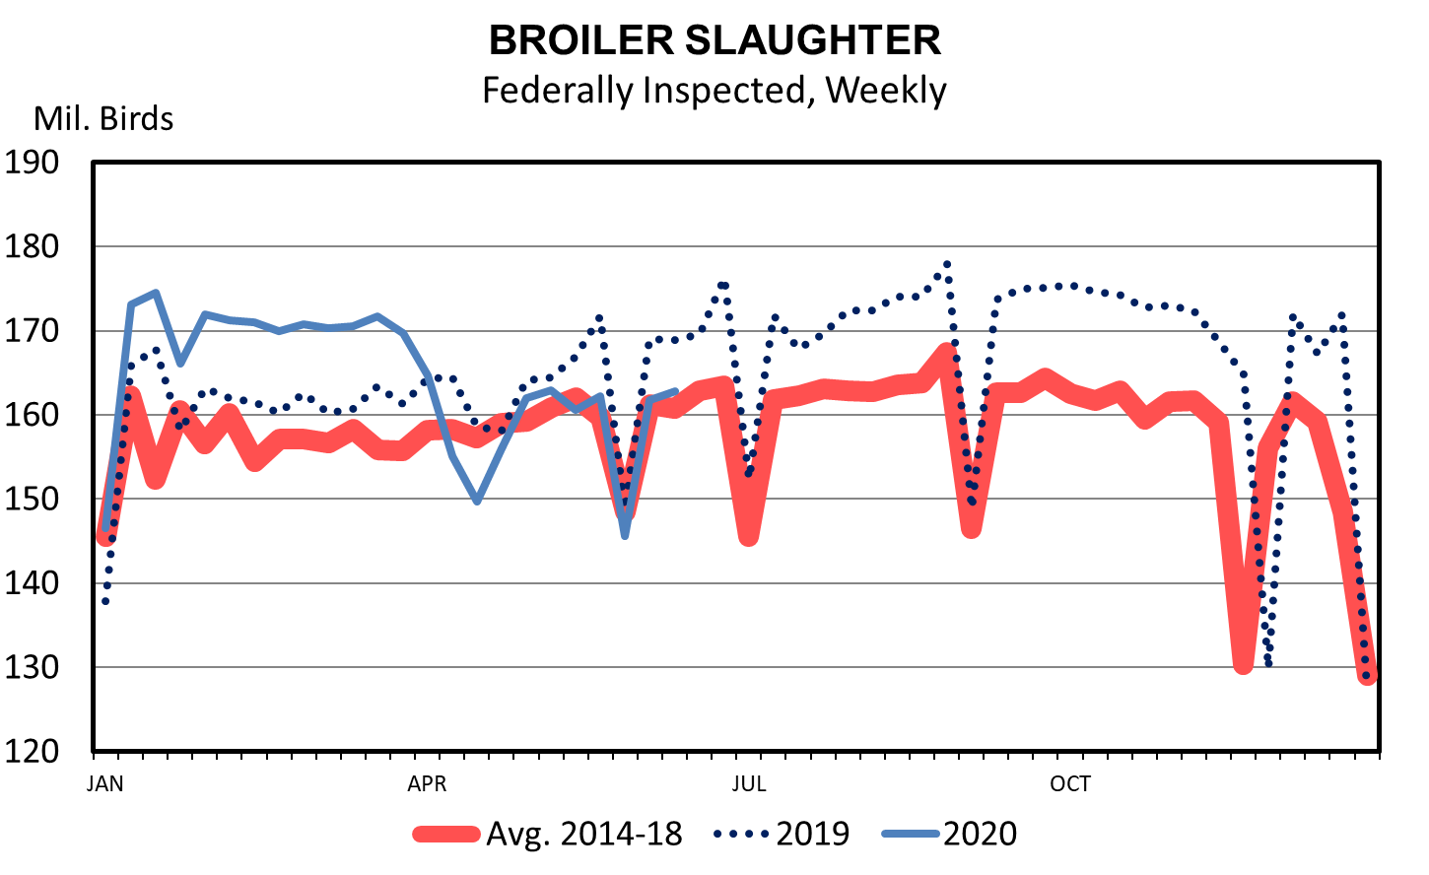
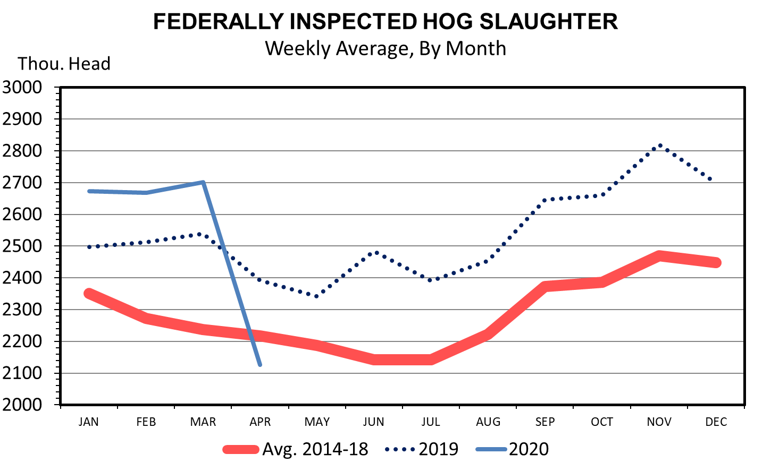
Pork and Poultry Slaughter
Pork Production Drop
In 2020 -2.3M -21%
From 2019 -1.1M -11%

Slide 5
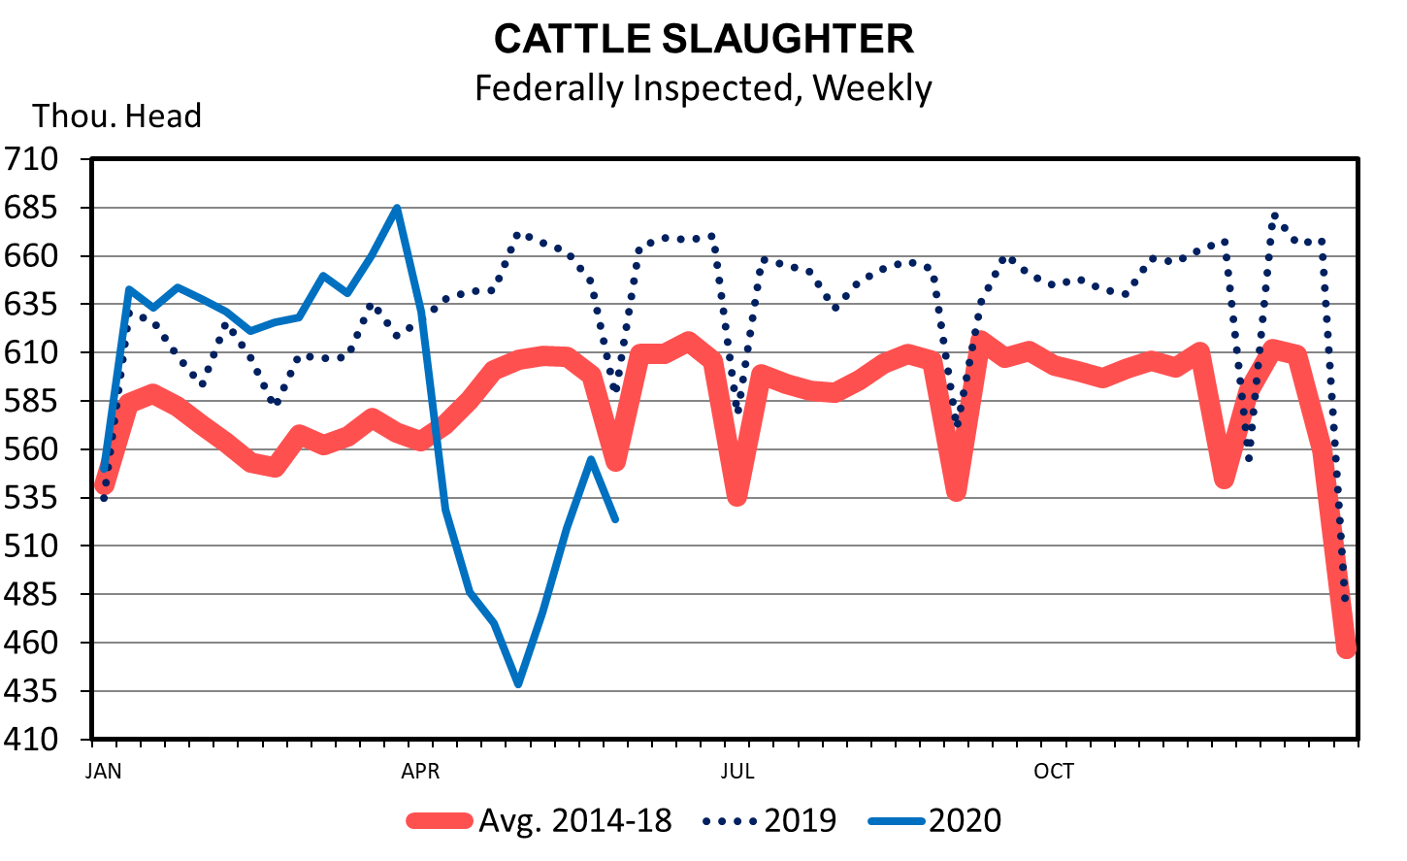
Covid cattle slaughter impact
Cattle Production Drop
From 2019 -1.2 M -11%

Slide 6
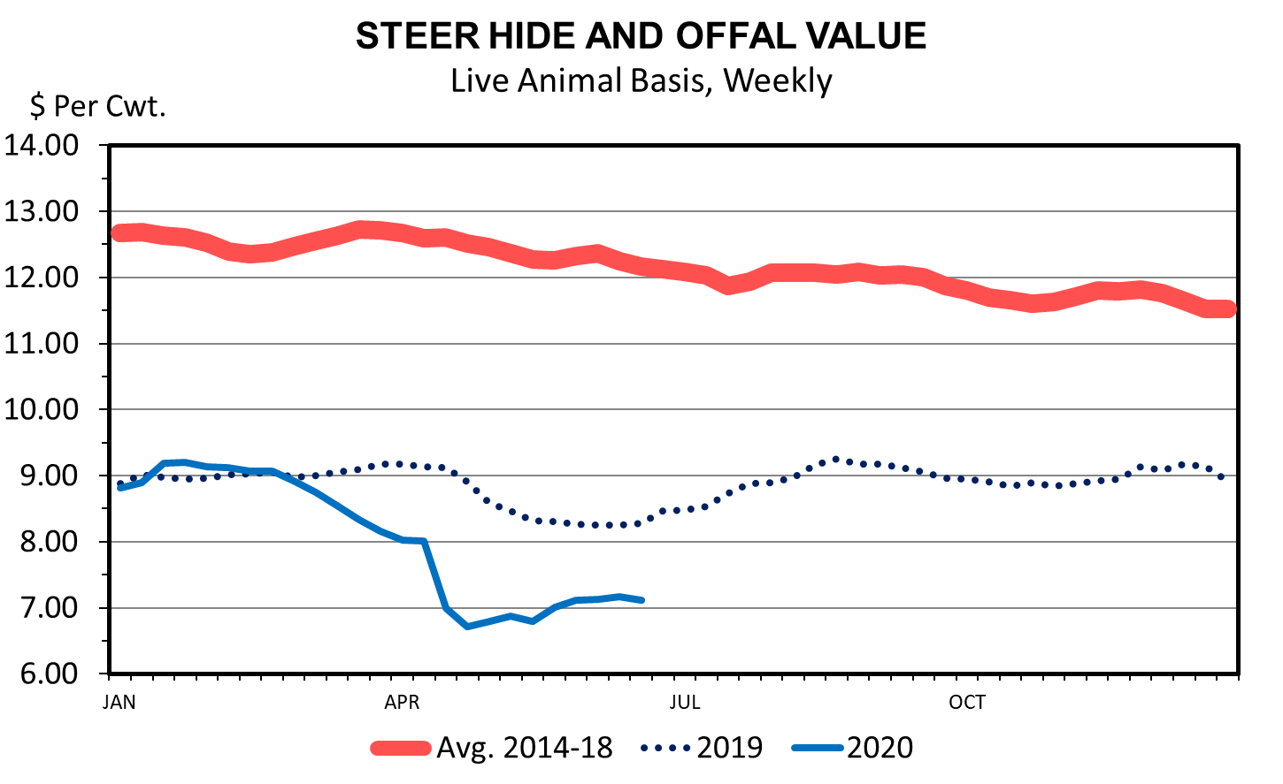
Global Economic Conditions Indicator

Slide 7
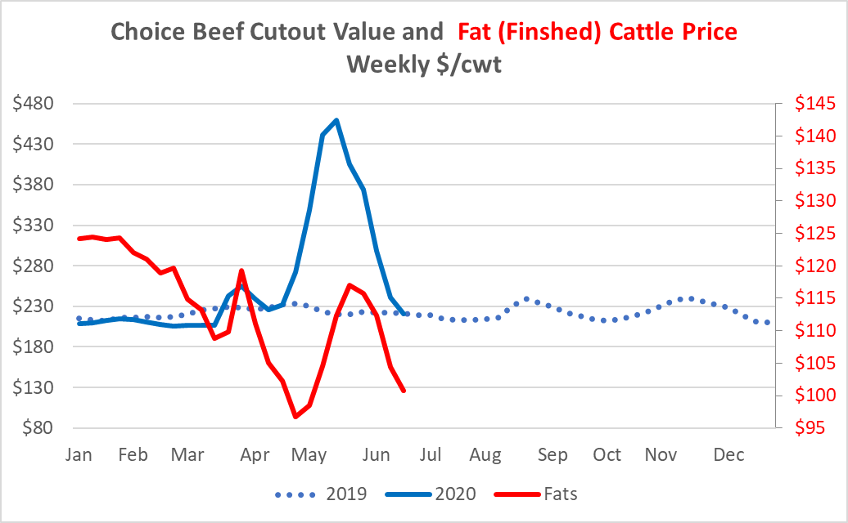
Wholesale Beef Choice Cutout Value vs Fat Cattle Price

Slide 8
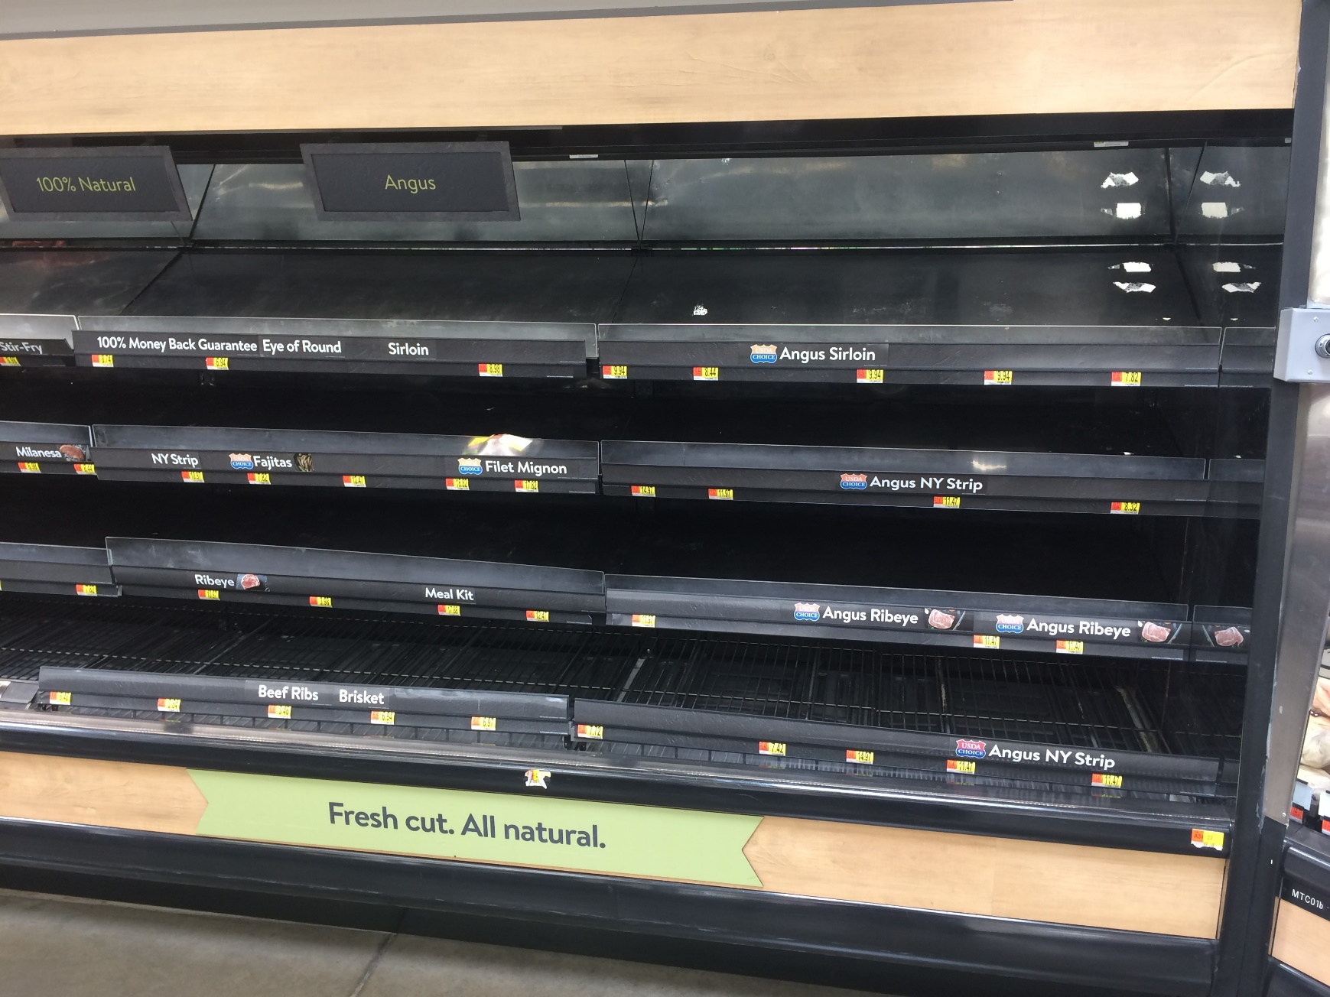
Pullman WA, Wall Mart empty beef meat case (May 24, 2020)

Slide 9
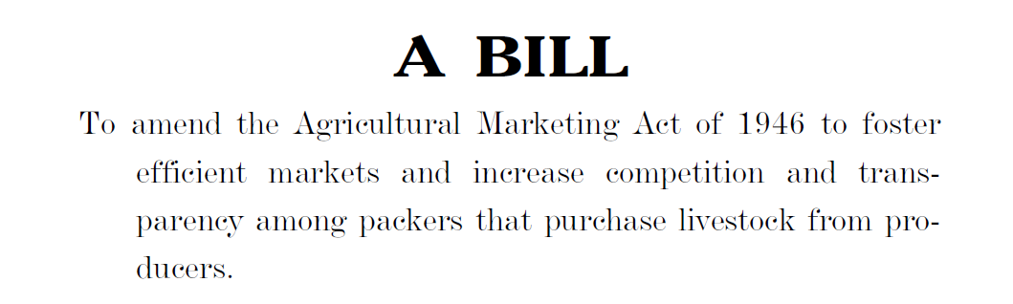
Call for investigation of alternative marketing agreements
Alternative Marketing Agreements (AMAs) are market transactions other than cash trade.
AMA are future contracts, partnership ownership, formula pricing
Senate Bill introduced to mandate packers > 125,000 head purchase 50% of their processed cattle through cash market sales from nonaffiliated producers 14 days prior to slaughter.
Koontz, Stephen (2020) A synthesis of Economic Costs and Benefits of AMAs to the Cattle and Beef Industry
  Inefficiency cost transferred back to feedlots, feeders and cow-calf
  Some impact to upper Midwest cattle feeding and packing
  Substantial impacts to southern plains and on producers that supply calves into that market
Notes:
Senators Jon Tester (D-MT) and Charles Grassley (R-IA)

Slide 10
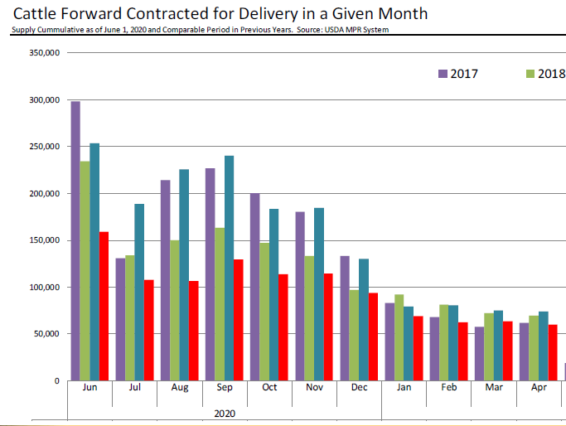
Current AMA data
Packers have significantly reduced the number of cattle they have contracted for delivery in the next few months.
USDA data on cattle contracted for delivery compared to 2019
  July – 43%
  August – 53%
  September – 46%
  October -38%
Why the decrease?
  Uncertain demand outlook in short-run
  Front end (back log of 1.2M head) cattle supply larger than a year ago
  Slaughter capacity has increased, but covid-19 remains a wild card that could disrupt slaughter and line speed
Daily Livestock Report 6-3-2020

Slide 11
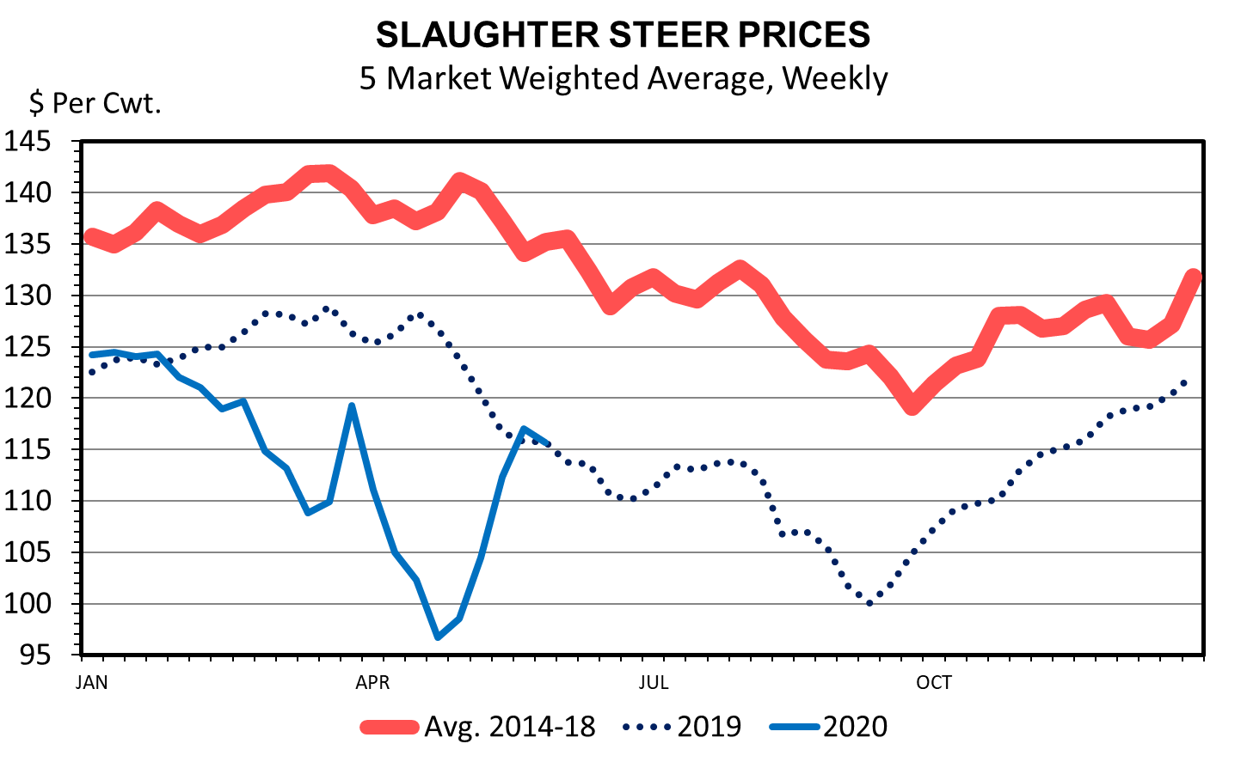
Drop and recovery in slaughter steer price

Slide 12
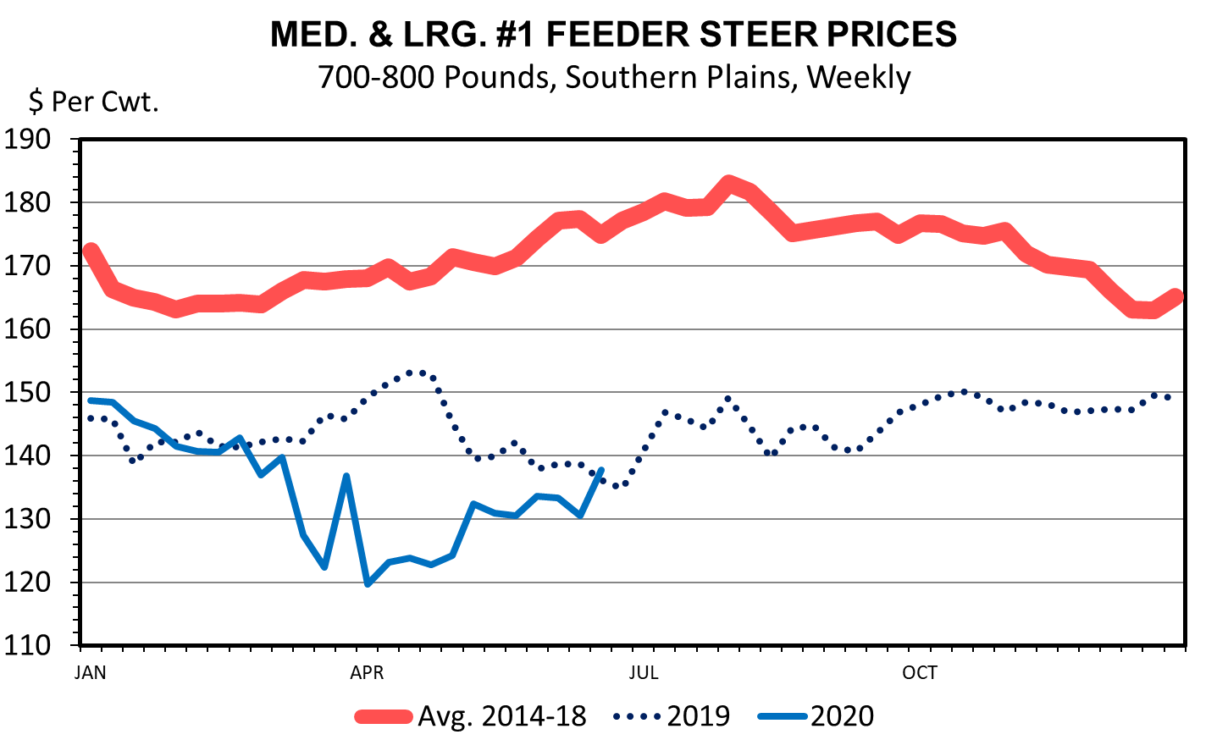
Feeder Cattle Prices

Slide 13
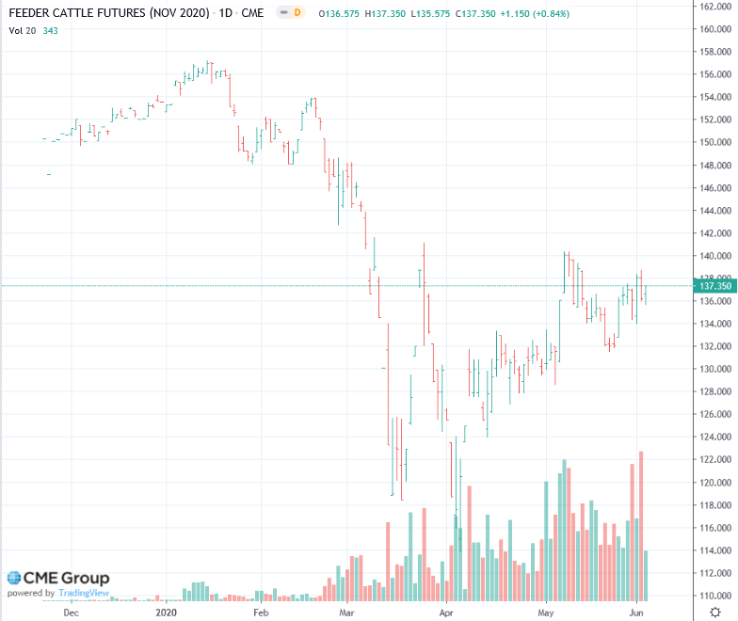
Feeder Cattle Futures
$136.00

Slide 14
Livestock Risk Protection Expected End Values
https://www.rma.usda.gov/en/Fact-Sheets/National-Fact-Sheets/Livestock-Risk-Protection-Feeder-Cattle
https://public.rma.usda.gov/livestockreports/main.aspx

Slide 15
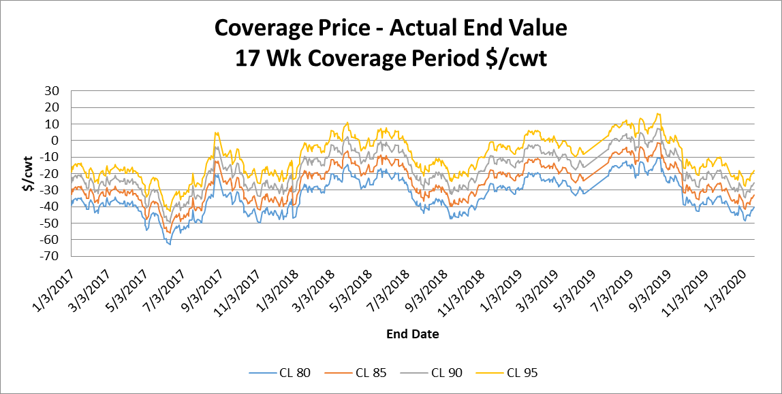
Importance of Coverage Level
Indemnity > 0
Indemnity < 0
Emily Fogarty, in-press. Analyzing Livestock Risk Protection to Mange Price Risk in Feeder Cattle

Slide 16
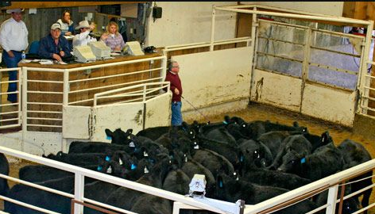
Important to note – you still need to bring calves to market
LRP only protects a price fall from your insured price.
The majority of revenue is dependent on weight delivered, local price, and quality premiums.

Slide 17
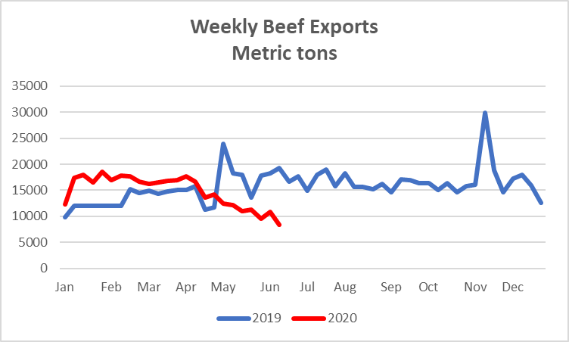
Demand Factor Exports

Slide 18
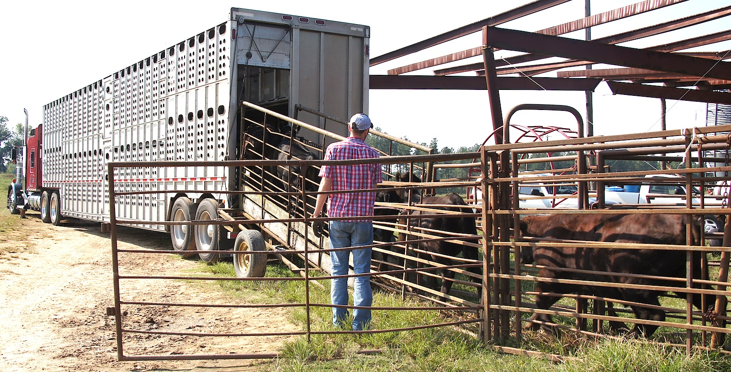
Need to deliver to market – consider ways to increase weight

Slide 19
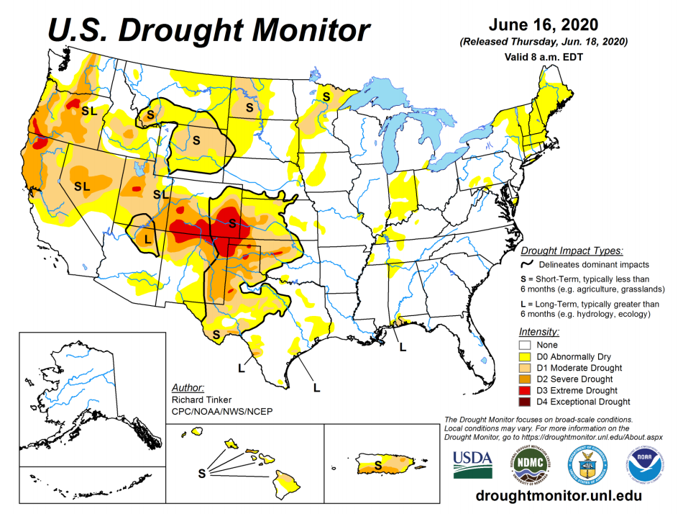
Domestic Demand hinges on economy and Covid management

Slide 20
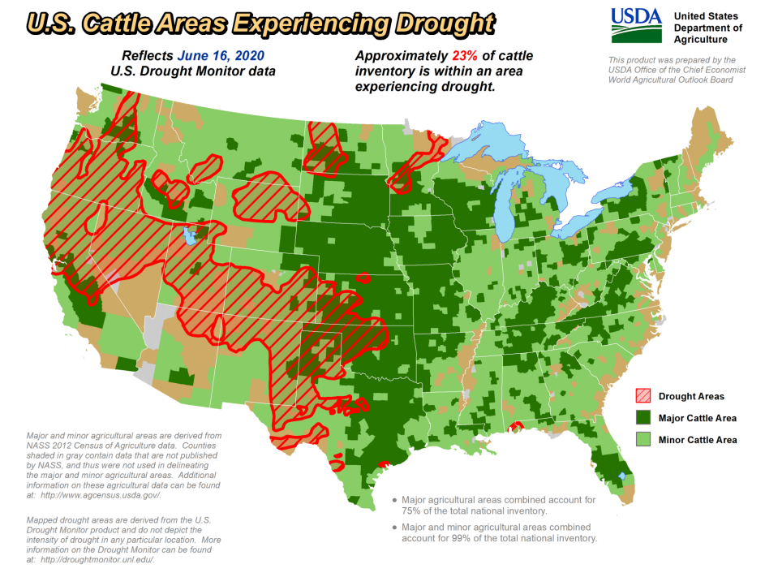
Domestic Demand hinges on economy and Covid management

Slide 21
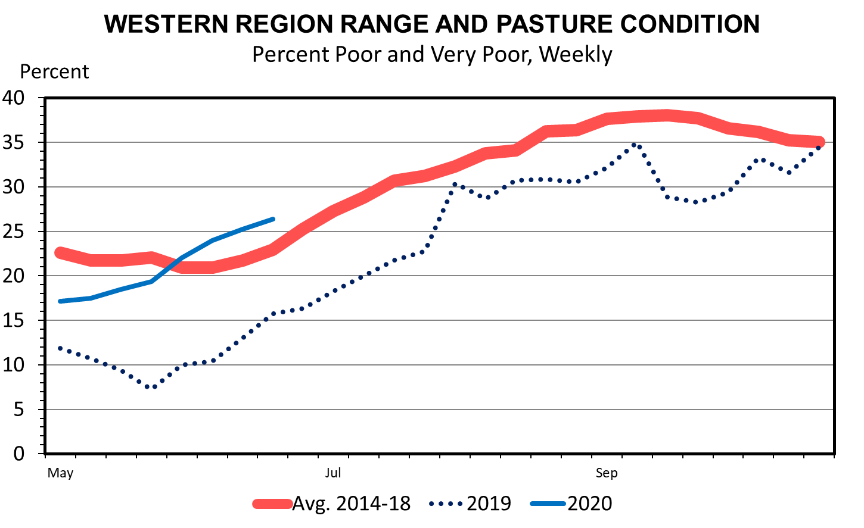
Domestic Demand hinges on economy and Covid management

Slide 22

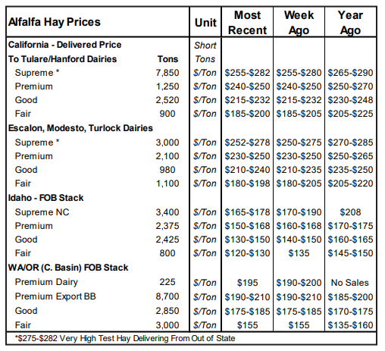
Current Hay Price – Softening
-$10 to -$20
-$20
-$20 or more
-$5 to -$10

Slide 23
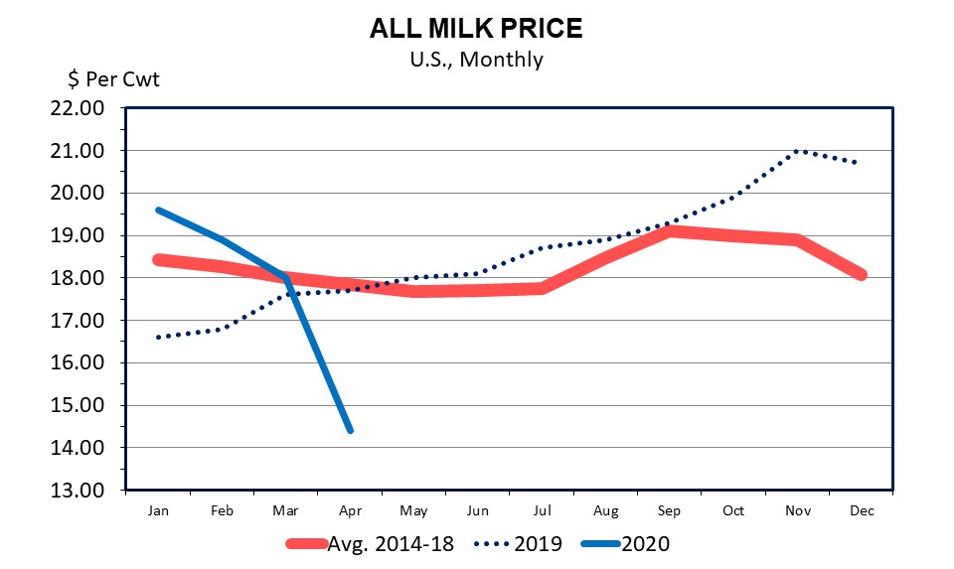
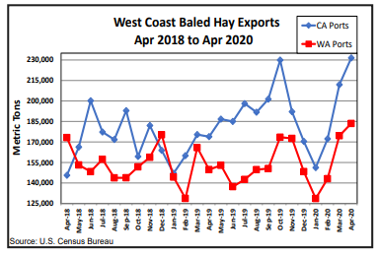
Hay Price Drivers

Slide 24
Human Covid-19 risk outlook
Factors that impact risk in the short-term and long-term recovery
Vaccine outlook
  Typical process:
  Exploratory, Pre-clinical animal trials, clinical human, regulatory review, manufacturing
  Year-end goal- optimistic, ambitious, not guaranteed, production capacity constraint, monopoly power, promising results, Oxford University ongoing trials, operation warp speed
Covid-19 second wave
  Social distancing not a cure or treatment
  Manage rate of infection
Herd immunity concept
  70% of population would need to be immune (> 200 million people)
  Scientists unsure if infected/recover leads to future immunity
  Limited/changing knowledge on mortality risk factors
Notes:
No vaccine, HIV/AIDS, Malaria,

Slide 25
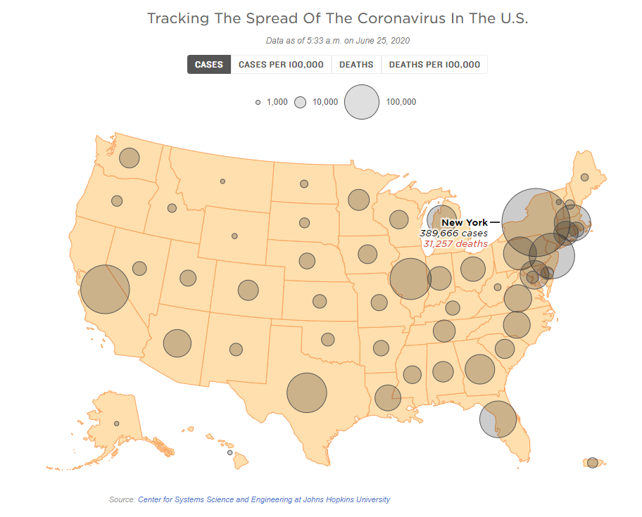

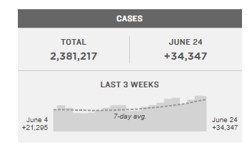
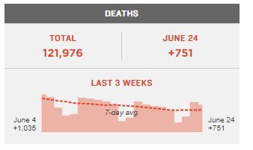
Domestic Demand – Covid Cases

Slide 26
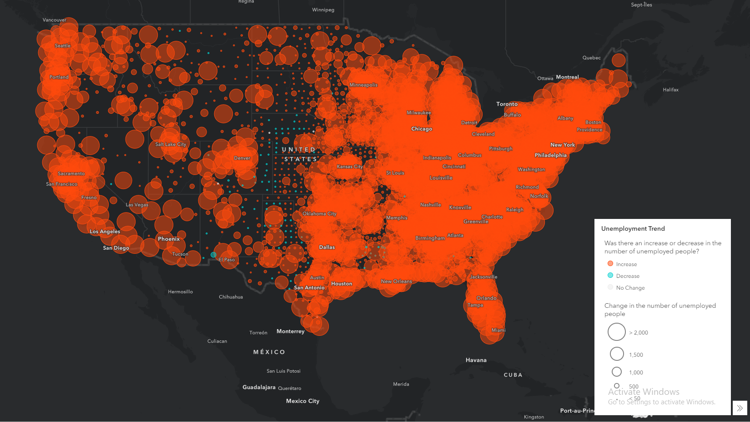
Domestic Demand - Unemployment
https://mediaprogram.maps.arcgis.com/apps/Media/index.html?appid=7a986a5f472a4ac4abc31b6a2c7e745a

Slide 27
Conclusions
Understatement to say Covid-19 is causing economic havoc and risk and uncertainty will persist with large downside risk potential
Federal deficit spending is unprecedented creating potential long term effects with potential risk to increase interest rates.
Agriculture commodity market prices are declining
  Declining exports
  Covid induced changes in domestic demand
  Cattle producers should be prepared for prices / revenue below what they received in 2019
  Producers should evaluate production practices to increase sale weight
CFAP and changes in LRP to help manage cash flow decrease

Slide 28

Discussion and Questions
Shannon Neibergs
sneibergs@wsu.edu
509 335 6360

Slide 29
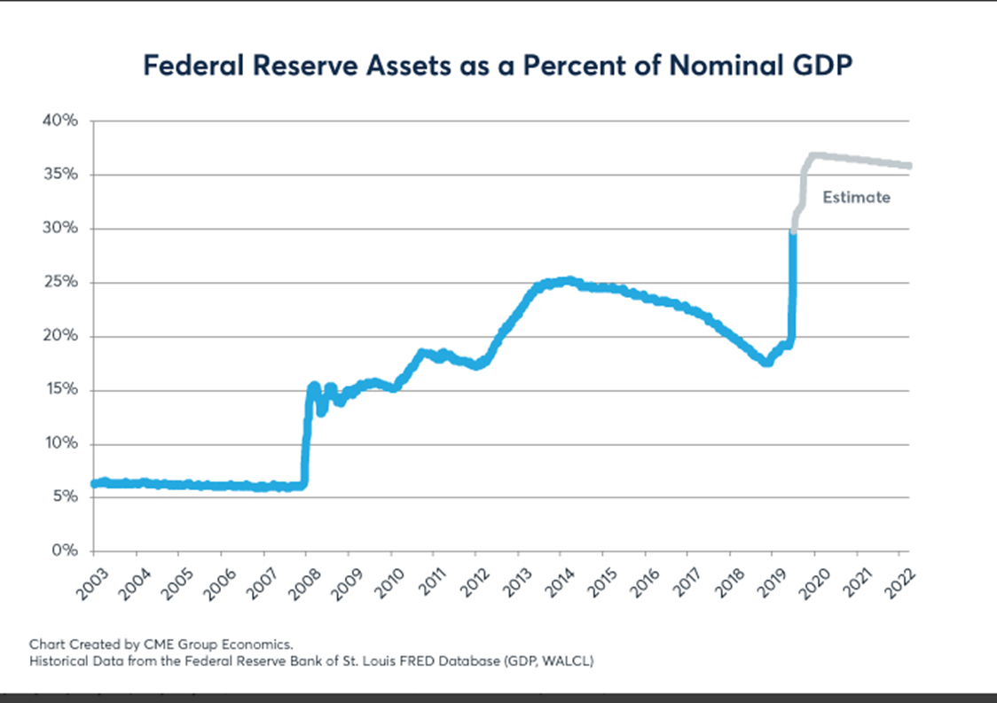
Macroeconomic Conditions - 1

Slide 30
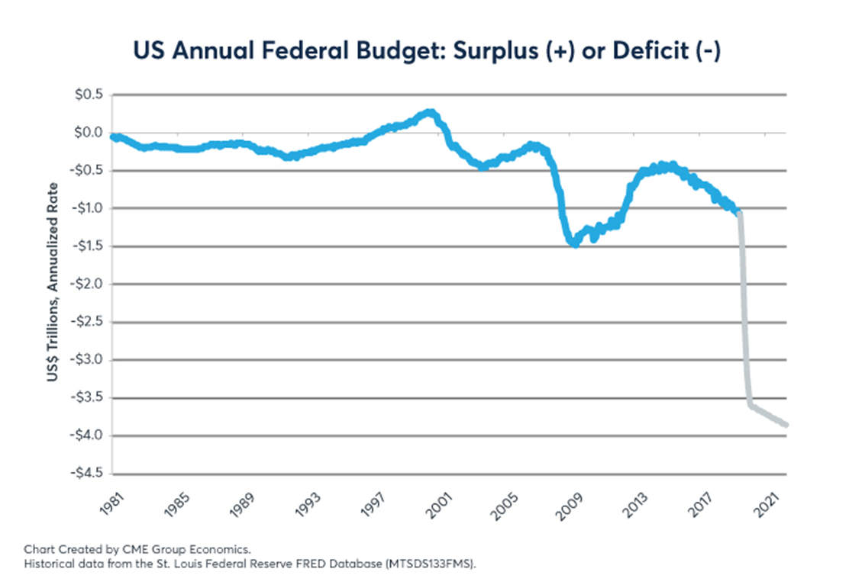
Macroeconomic Conditions - 2

Slide 31
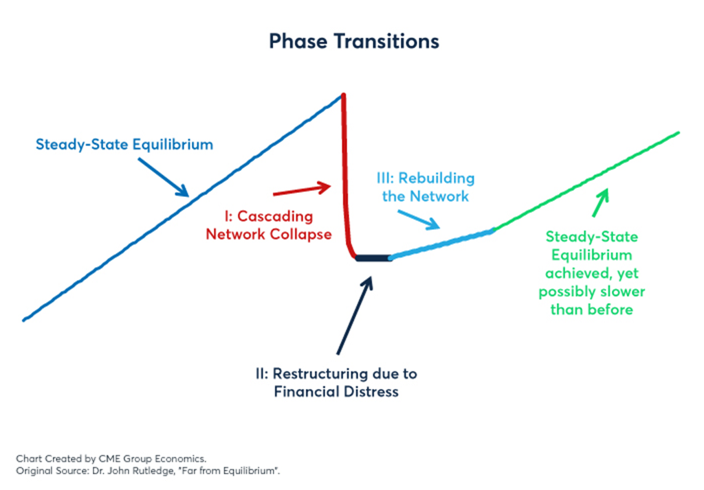
Rebuilding the global economy
https://www.cmegroup.com/education/featured-reports/policy-analysis-through-the-lens-of-phase-transitions.html?utm_source=pardot&utm_medium=email&utm_campaign=economic_research

Slide 32
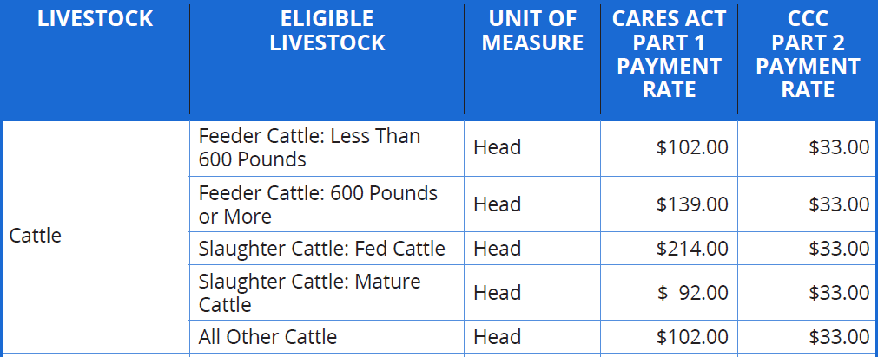
CARES Act and CFAP
FSA administered program
CFAP is available to livestock producers who own eligible livestock that have suffered a price decline and face additional losses in marketing their inventories.
  Actual Sales between January 15, 2020 to April 15, 2020
  Inventory between April 16, 2020 to May 14, 2020
https://www.farmers.gov/sites/default/files/documents/FSA_CFAP_ForLivestock_Fact-Sheet.pdf
Notes:
CARES coronavirus aid relief and economic security act
to compensate farmers for losses due to price declines that occurred between mid-January 2020, and mid-April 2020
Cattle producers will be the largest recipients of aid at roughly $5 billion. The payments break down several different ways depending on the type of cattle, if they were sold from Jan. 15 to April 15:
-- Fed cattle for slaughter: $214 per head.
-- Slaughter cows and bulls: $92 a head.
-- Feeder cattle under 600 pounds: $102 a head
-- Feeders over 600 pounds: $139 a head
-- All other cattle: $102 a head
Unpriced cattle in inventory from April 16 to May 14 receive a flat rate from the Commodity Credit Corp. of $33 a head. Producers can basically pick a date of their choosing in that time frame and report their inventory to USDA.

