Slide 1
COVID-19: Training Opportunities
Taylor Lensch, Zach Dupin, Gerold Dermid
Nevada Public Health Training Center

Slide 2
UNR
SCHS
NVPHTC

Slide 3
COVID Response at the NV Public Health Training Center
Contact Tracing (~50 contact tracers/supervisors/managers)
Washoe County Health District
Carson City Health and Human Services
NV Public Health Training Center (rural communities)
COVID-19 Call Center (~20 call center staff)
COVID-19 testing support (~20 testing staff)

Slide 4
COVID Response at the NV Public Health Training Center
Monitor and evaluate the efficiency and effectiveness of our contact tracing efforts
Provide technical assistance related to contact tracing and COVID response
COVID-related capacity building and training

Slide 5
What does contact tracing involve?
Interviewing people with COVID-19 to identify everyone they had close contact with during the time they may have been infectious
Notifying contacts of their potential exposure
Referring contacts for testing
Monitoring contacts for signs and symptoms of COVID-19
Connecting contacts with services they might need during the self-quarantine period
CDC – Contact Tracing, 2020.

Slide 6
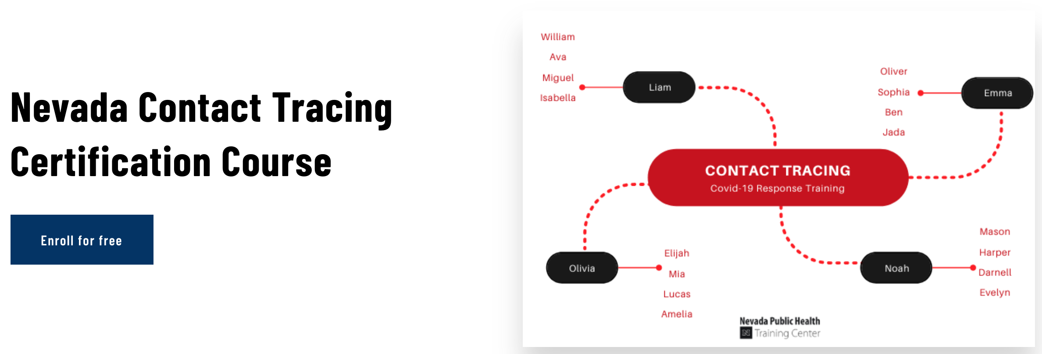
Our Trainings
Available for free: makinghealthhappen.org

Slide 7
Nevada Contact Tracing Certification Course
Association of State and Tribal Health Organization (ASTHO) Contact Tracing Training
3 hours
Johns Hopkins Contact Tracing Training (through Coursera)
6 hours
Nevada-specific Contact Tracing Presentation
2 hours

Slide 8
Topics covered in the trainings
Basics of the SARS-CoV2 virus and COVID-19
Basic of Contact Tracing
Interviewing techniques
Building rapport
Strategies for effective communication
Handling difficult situations
Data Quality
Maintaining Confidentiality and Ethical Standards

Slide 9
Other Trainings

Slide 10
COVID-19 Series
Currently 10 available and more upcoming!
All for free!
Special COVID-related topics
Brief and effective communication strategies
Mental health during COVID
Importance of vaccinations
Live every Friday at 10 AM
All trainings are recorded and can be watched on your own time (makinghealthhappen.org)

Slide 11
Upcoming – July 31 (10 AM)
Register: makinghealthhappen.org

Slide 12
Additional Training
We are also happy to develop tailored trainings specific to individual community needs
Zoom or in-person

Slide 13
Technical Assistance
Taylor Lensch
Contact Tracing Manager (tlensch@unr.edu)
Zach Dupin
Contact Tracing Supervisor (zdupin@unr.edu)
Gerold Dermid
Director of Nevada Public Health Training Center (gdermid@unr.edu)

